Slide 1
3-2B and 3-2D:
Frequency Tables and Line Plots
6th Grade Advanced/Pre-IB Math

Slide 2

Frequency Tables
What does the word “frequent” mean?
Frequent means something that occurs often.
Frequency tables show how often pieces of data fall within a given interval

Slide 3
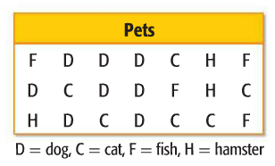
Example
The table shows the kinds of pets students have. Make a frequency table of the data. Then describe the mode.
Pet
Dog
Cat
Fish
Hamster
Tally
IIII III
IIII I
IIII
III
Frequency
8
6
4
3
Most students have dogs as pets.

Slide 4
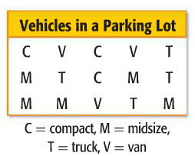
Rally Coach
The table shows the kinds of vehicles that are in a parking lot. Make a frequency table of the data. Then describe the mode.
Vehicle
Compact
Midsize
Truck
Van
Tally
III
IIII
IIII
III
Frequency
3
5
4
3
Most people have midsize vehicles.

Slide 5
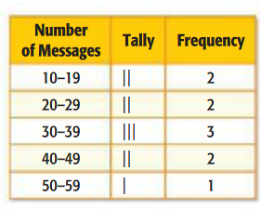
Think Pair Share
Why might you have to use intervals when creating a frequency table?
It is important for your “Frequency” column to have numbers close together (evenly distributed).

Slide 6
Rally Coach
WB p. 49-50 ALL
You have 10 minutes

Slide 7
BRAIN BREAK

Slide 8
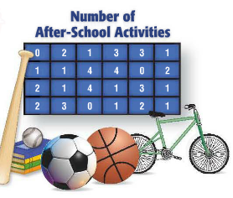

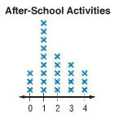
Line Plots
A way to show data spread out on a number line
Step 1: Draw a number line based on the numbers in the data set
Step 2: Place as many Xs above each number as there are responses for that number

Slide 9
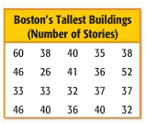

More Line Plots
Example: The number of stories in the tallest buildings in Boston, Massachusetts, are shown in the table. Display the data in a line plot.
Discuss at your table how to draw the number line for this data set.

Slide 10
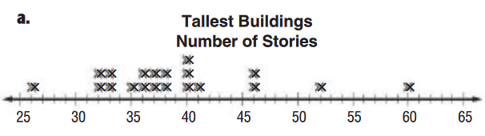
Example continued
In the Boston example, there are gaps in the data
Because there are gaps in the data, let’s use intervals to draw the number line

Slide 11
HOMEWORK
WB pages 51-52 ALL due Monday (white) and Tuesday (green)

