Slide 1
Write and Evaluate Expressions
Lessons 6-1A and 6-1B

Slide 2
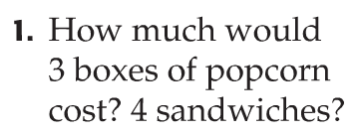
What is an expression?
3 × 2= 6; $6.00
4 × 4 = 16; $16.00
6 + 16 = 22; $22.00
Multiplication was used in Exercise 1 and addition was used in Exercise 2.
The steps can be combined into one problem: (3 × 2) + (4 × 4)

Slide 3
What is an expression?
You have probably used the Order of Operations in fifth grade…but be careful! In sixth grade we will see subtraction come before addition and division come before multiplication. This might change your understanding…SO PAY ATTENTION!!!

Slide 4
Solving an Expression
It is important to know that you might divide before you multiply if it comes first!
It is important to know that you might subtract before you add if it comes first!

Slide 5
Solve an Expression

Slide 6
Now You Try!
Now You Try!
Here you must divide first, because it appears before the multiplication!
10 + 30
8 × 4
40
32

Slide 7
Now You Try!
More Examples: First with Parentheses…
Notice how the problem is solved one step at a time. This makes your work look like a funnel or tornado!
Parentheses always come first!

Slide 8
Now You Try!
More Examples: First with Parentheses…
Exponents are evaluated after there are no more parentheses.
I’m here again to see that you solve only one step at a time! I better write that down!

Slide 9
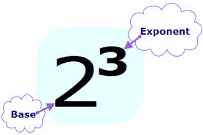
Now You Try!
About Exponents
Your Turn Again!
2 × 2 × 2
4× 2
25 × 3 ÷ 5 - 12
24 ÷ 8 + 6
8
75 ÷ 5 - 12
3 + 6
So, 2³
means 2 times itself a total of three times.
15 - 12
9
3

Slide 10
Write an Expression
Notice in this problem that “of” means to multiply. This should be familiar to you now!

Slide 11
Write an Expression
I like what I see!

Slide 12
Now You Try!
Now You Try!
Check your form to see if it looks like mine!
4 × 3 + 4 × 1 + 4 × 2
12 + 4 × 1 + 4 × 2
12 + 4 + 4 × 2
12 + 4 + 8
16 + 8
24

Slide 13
BRAIN BREAK

Slide 14
What About Variables?
All variables should be lower case. You should avoid using the letter “o” as it looks like a zero!

Slide 15
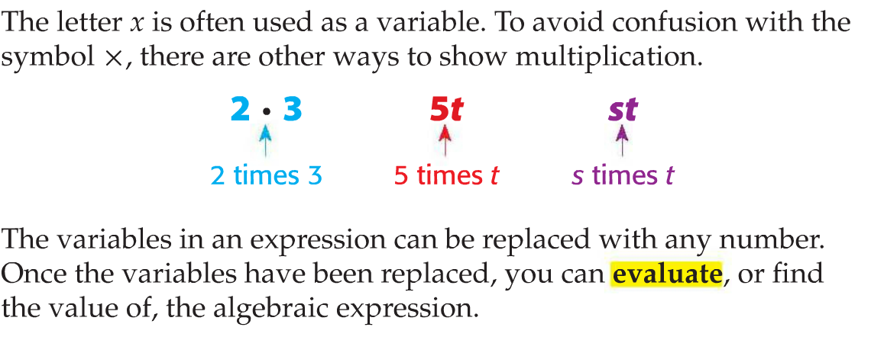
What About Variables?
So, the difference between an Expression and an Algebraic Expression is the presence of variables.

Slide 16
Examples of Solving Algebraic Expressions
You will ALWAYS follow these steps:
1. Write the expression,
2. Substitute for the variable(s),
3. Solve using the Order Of Operations

Slide 17
Examples of Solving Algebraic Expressions
The three critical steps:
1. Write the expression,
2. Substitute for the variable(s),
3. Solve using the Order Of Operations
In this problem, the operations just happened to appear in the Order of Operations order. Be careful…this won’t happen often!

Slide 18
Now You Try!
Remember, a number touching a variable or a variable touching a variable means to multiply!
Let’s Try some Algebra!
6 + 8
6 - 4
6 • 4
2 • 6 - 5
14
2
24
12 - 5
7

Slide 19
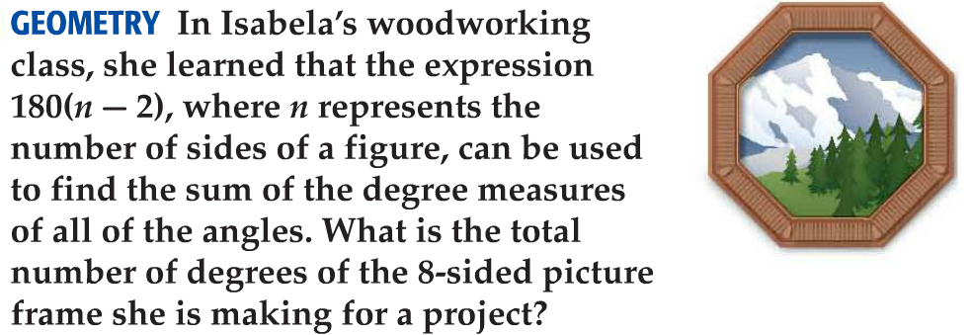
Real-World Example
Don’t worry. They give you the formula. Can you find it and the value of “n” in this question?

Slide 20
Real-World Example
I forgot to remind you, a number touching a parenthesis also means to multiply!

Slide 21
Now You Try!
Now You Try!
Oh, I can’t forget that!
7 + 2t
7 + 2 • 5
7 + 10
17
So the total cost is $17.00

Slide 22
Now You Try!
Shoulder Partner Practice
On lined paper, complete questions 1 through 7 on page 326. Be sure to put your regular heading on the paper.
You may check your answers with your shoulder partner and resolve any discrepancies.
Each student must turn in this assignment prior to beginning their homework.
Tonight’s homework is Workbook pages 89 odd and 91 odd.
Show your work on lined if you do not have enough room.

