Slide 1
Opening Activity Mid Chapter Check
# 2, 4, 6, 8, 13, 14, 18, 19
Take out a piece of notebook paper
Put your proper heading in the upper right hand corner
The title is “Chapter 6 Mid Chapter Check.”

Slide 2
6-2C:
The Distributive Property

Slide 3
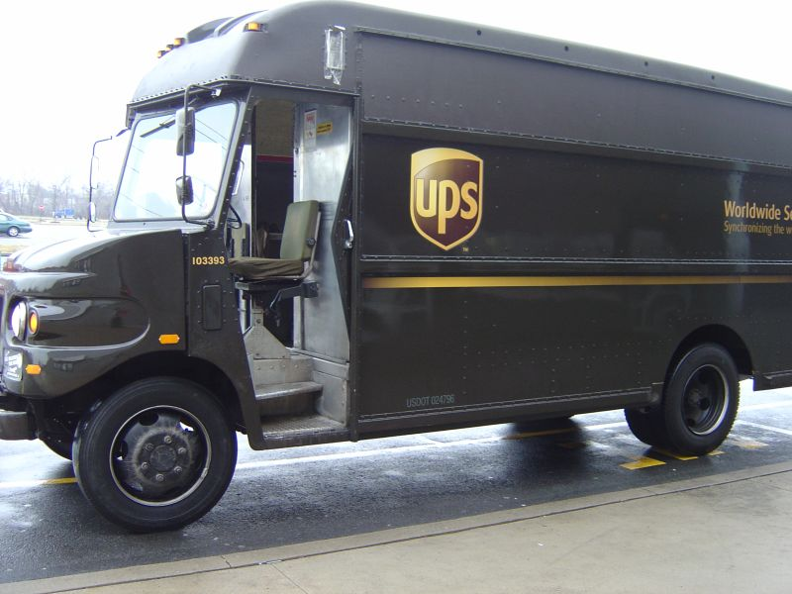
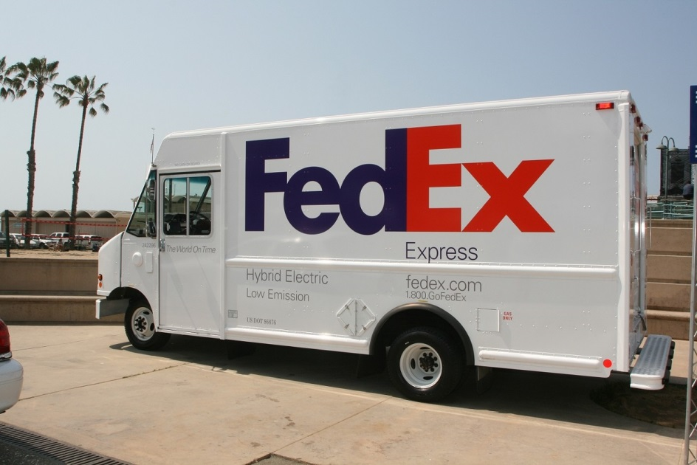
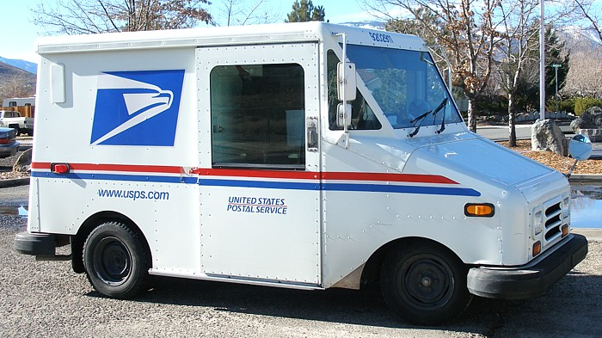
Where have you heard the word distribute?

Slide 4
Write this down!!

Slide 5
Example 1
Separate the mixed number.

Slide 6
Rally Coach Solve using the Distributive Property.
13
27
7.2

Slide 7
Example 2
Jack and four of his friends buy sandwiches and drinks for lunch. They each pay $6 for a sandwich and $3 for a soda. How much money do they spend altogether?
5 people
$6 sandwich
$3 soda
How much would it cost for one person?

Slide 8
Solving Example 2 Using 2 Methods
5(6 + 3)
Method 1: Add within the ( )
Method 2: Distribute
5(6 + 3)
5 $×$ 6 + 5 $×$ 3
5(9)
30 + 15
45
45

Slide 9
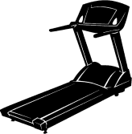
Choose Your Method and SOLVE
7(10+25)
7(10 + 25)
7 $×$ 10 + 7 $×$ 25
7(35)
70 + 175
245
245

Slide 10
Example 3

Slide 11
Solve SOLO
8x + 24
5x + 45
2x + 6

Slide 12
BRAIN BREAK

Slide 13
Take out your workbook
You have 10 minutes to work on your homework (pages 99-100 ODDS)

Slide 14
Reminders:
**WB pages 99-100 due Friday (white) or Monday (green)
**Chapter 6 Test Friday (white) or
Monday (green)
**Extra credit: Chapter 6 Practice Test
(odds only)

