Slide 1
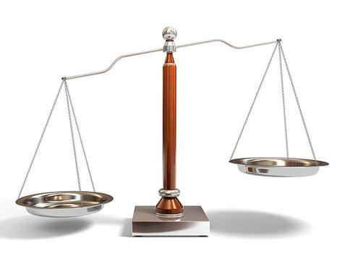
7-1A, C, and D: Solving and Writing Addition Equations
6th Grade Advanced/Pre-IB Mathematics

Slide 2
What is an Equation?
A mathematical sentence showing two expressions are equal
Example: 2 + 7 = 9
Recall: How are equations different from expressions?

Slide 3
Think Pair Share
How is a balance or scale similar to an equation?
7 + 2
=
9

Slide 4
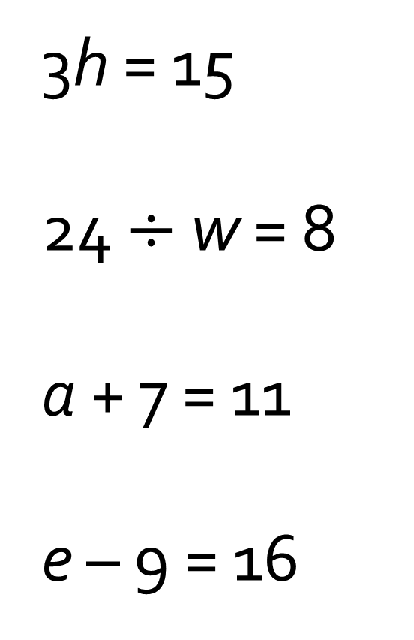
Solve each equation mentally
3h = 15
24 $÷$ w = 8
a + 7 = 11
e – 9 = 16
h = 5
w = 3
a = 4
e = 25

Slide 5
Example

Slide 6
Practice using the “balance” idea or “guess and check”
1. 1 + x = 8 2. x + 2 = 7 3. 9 = x + 3
1 + 7 = 8
5 + 2 = 7
9 = 6 + 3

Slide 7
Inverse Operations
What is the opposite of adding?
** In addition questions, we are really SUBTRACTING to solve the problem
8 = x + 3
Our goal is to “isolate” the variable. (It wants to be alone!)
Whatever you do to one side, you must do to the other!
- 3 - 3
5 = x

Slide 8
Solve using inverse operations. Remember to isolate the variable.
- 2 - 2
- 5 - 5
- 3 - 3
c = 3
1 = x
y = 9

Slide 9
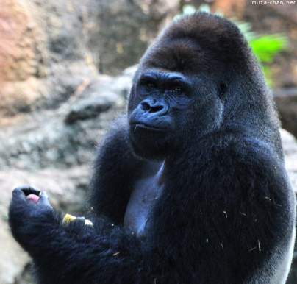
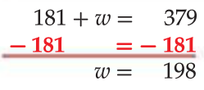
Writing Addition Equations
So, the average female gorilla weighs 198 pounds.

Slide 10
Your Turn!
7 + p = 19
The other piece measures 12 meters.
- 7 - 7
p = 12

Slide 11
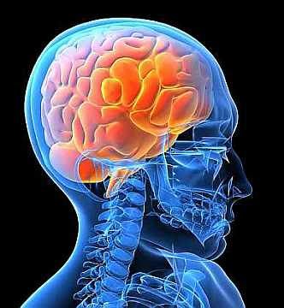
Brain Break

Slide 12
Round Table
Your team will receive one piece of colored paper
Draw 8 boxes on your paper
Each team member will take turns solving various problems on page 375
Solve #8, 10, 12, 14, 16, 18, 20, 22

Slide 13
Homework
WB pages 101-102 and 105-106 ODDS due Thursday (white) and Friday (green)

