Slide 1
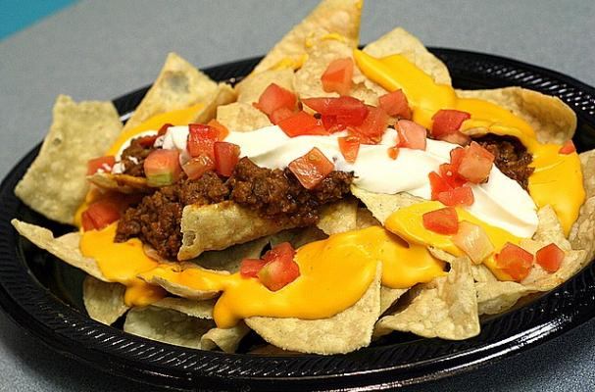
Bellwork (in your spirals)
Six friends agree to split the cost of a plate of nachos that cost $18. Write and solve a multiplication equation to determine how much each friend will pay.
$$6n=18$$
$6$ $6$
$n=3$ Each friend will pay $3.

Slide 2
7-2C and D: Division Equations
6th Grade Advanced/Pre-IB Mathematics

Slide 3
Quickwrite
Based on how we have solved addition, subtraction, and multiplication equations, what are your predictions for how we will solve division equations?

Slide 4
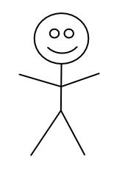
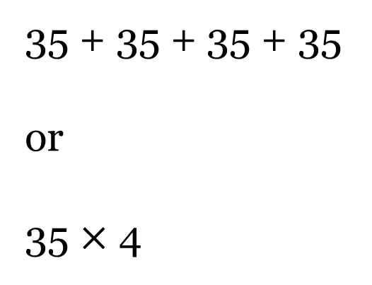
Example
Four friends decided to split the cost of concert tickets equally. Each person paid $35. Find the total cost of the concert tickets.
Draw a picture
Work backwards
$35
$35
$35
$35
35 + 35 + 35 + 35
or
35 $×$ 4
= $140

Slide 5
Practice (draw a picture or work backwards)
Mrs. Horn, Mrs. Batchelor, and Mrs. Corlett went to a teacher conference. They shared the cost of gasoline. Each teacher paid $38.50. Find the total cost of gasoline.
Antonio bought a shirt for ½ off. He paid $21.75 for the shirt. Find the original cost of the shirt.
38.50 + 38.50 + 38.50 or 38.50 $×$3
= $115.50
= $43.50
21.75 + 21.75 or 21.75 $×$2

Slide 6

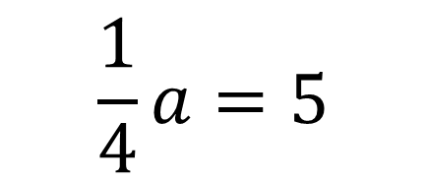
Writing Division Equations
Leslie spends $5 a month on snacks at school, which is one fourth of her monthly allowance. How much is Leslie’s monthly allowance?
Let a represent Leslie’s monthly allowance
Can you think of other ways to write this division equation?
$$\frac{a}{4}=5$$
$$\frac{1}{4}a=5$$
$$a ÷4=5$$

Slide 7



How Solve Division Equations
Use the inverse operation of division, multiplication, to solve
$$×4$$
$$\frac{a}{4}=5$$
$$×4$$
Remember, whatever you do to one side, you must do to the other!!
$$a=20$$

Slide 8
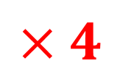
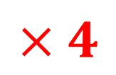
How Solve Division Equations (cont.)
You could also solve the same problem written this way…
$$a ÷4=5$$
So, Leslie’s monthly allowance is $20.
$$×4$$
$$×4$$
$$a=20$$

Slide 9
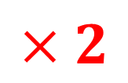
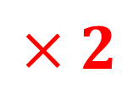
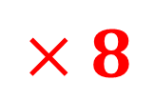
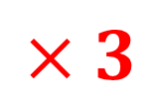

Check Your Progress
$$×2$$
$$×2$$
$$×8$$
$$×8$$
x = 72
b = 60
$$\frac{a}{3}=60$$
$$×3$$
Nathan could pick 180 apples in 1 hour.
$$×3$$

Slide 10
Brain Break

Slide 11
Stand Up, Hand Up, Pair Up
Take out a piece of notebook paper
Put your proper heading in the right corner, and title it “Stand Up, Hand Up, Pair Up”
Turn to page 392 in your textbook

Slide 12
Stand Up, Hand Up, Pair Up Problems (page 392)
Round 1 - #13
Round 2 - #17
Round 3 - #23
Round 4 - #24

Slide 13
Homework
WB pages 111-112 ODDS due Thursday (white) or Friday (green)

