Slide 1

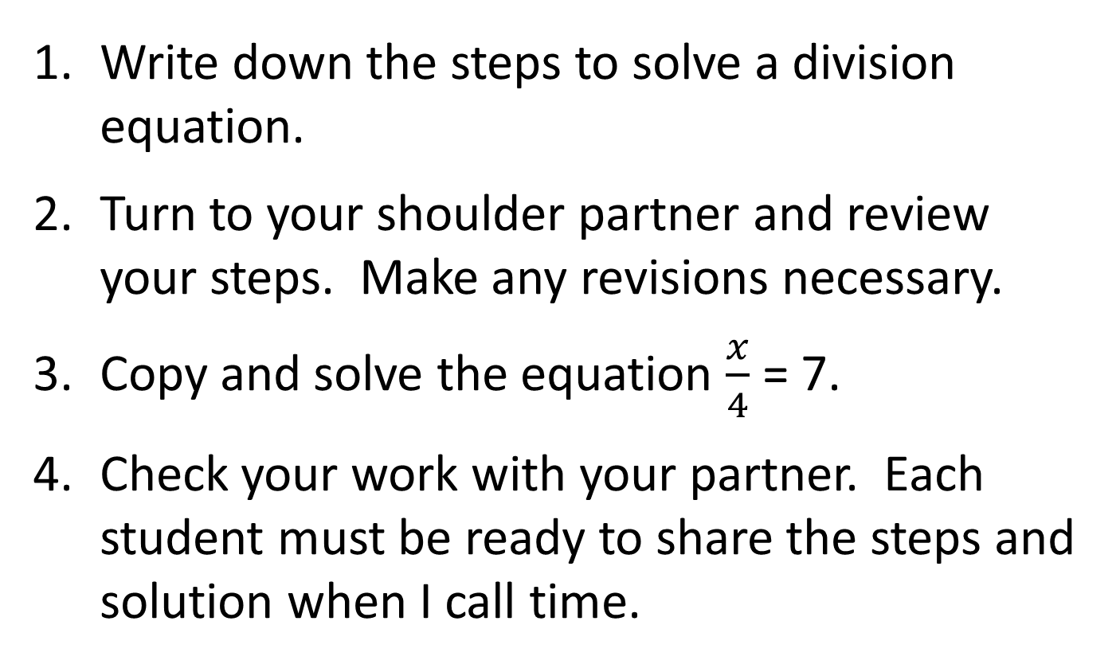
(In Your Spirals)
Bell Ringer
Write down the steps to solve a division equation.
Turn to your shoulder partner and review your steps. Make any revisions necessary.
Copy and solve the equation $\frac{x}{4}$ = 7.
Check your work with your partner. Each student must be ready to share the steps and solution when I call time.

Slide 2
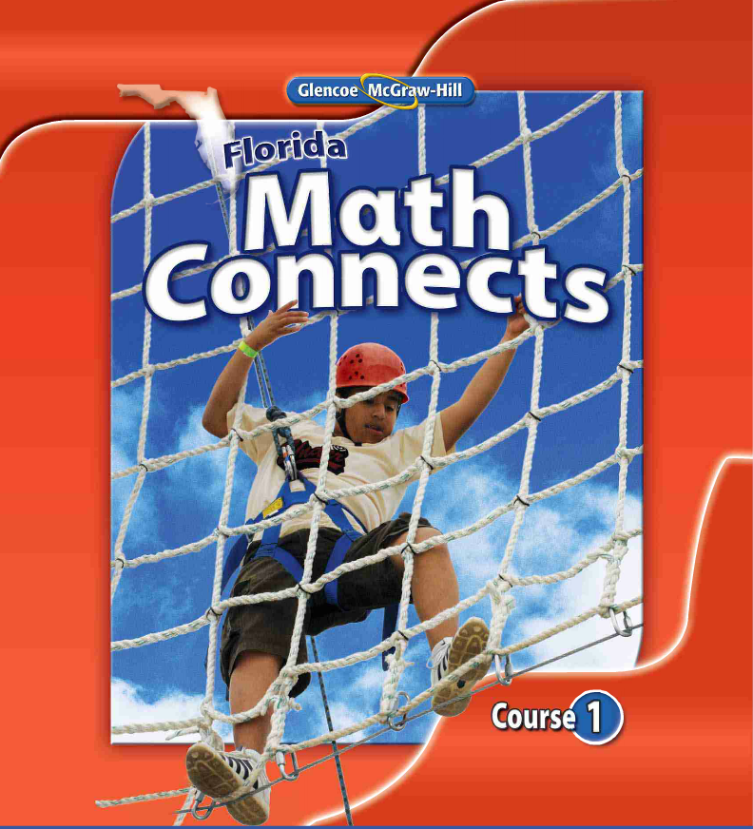
7-3 A & B Two-Step Equations

Slide 3
Learning Goal 602
Reason about and solve one-variable equations and inequalities.
Learning Objectives:
I understand that a variable (letter) represents an unknown number or set of numbers.
I can use variables (letters) to represent numbers in expressions and inequalities.
I can determine if a set of numbers makes an inequality or expression true.
I can write and solve an equation or inequality in order to answer a question.

Slide 4
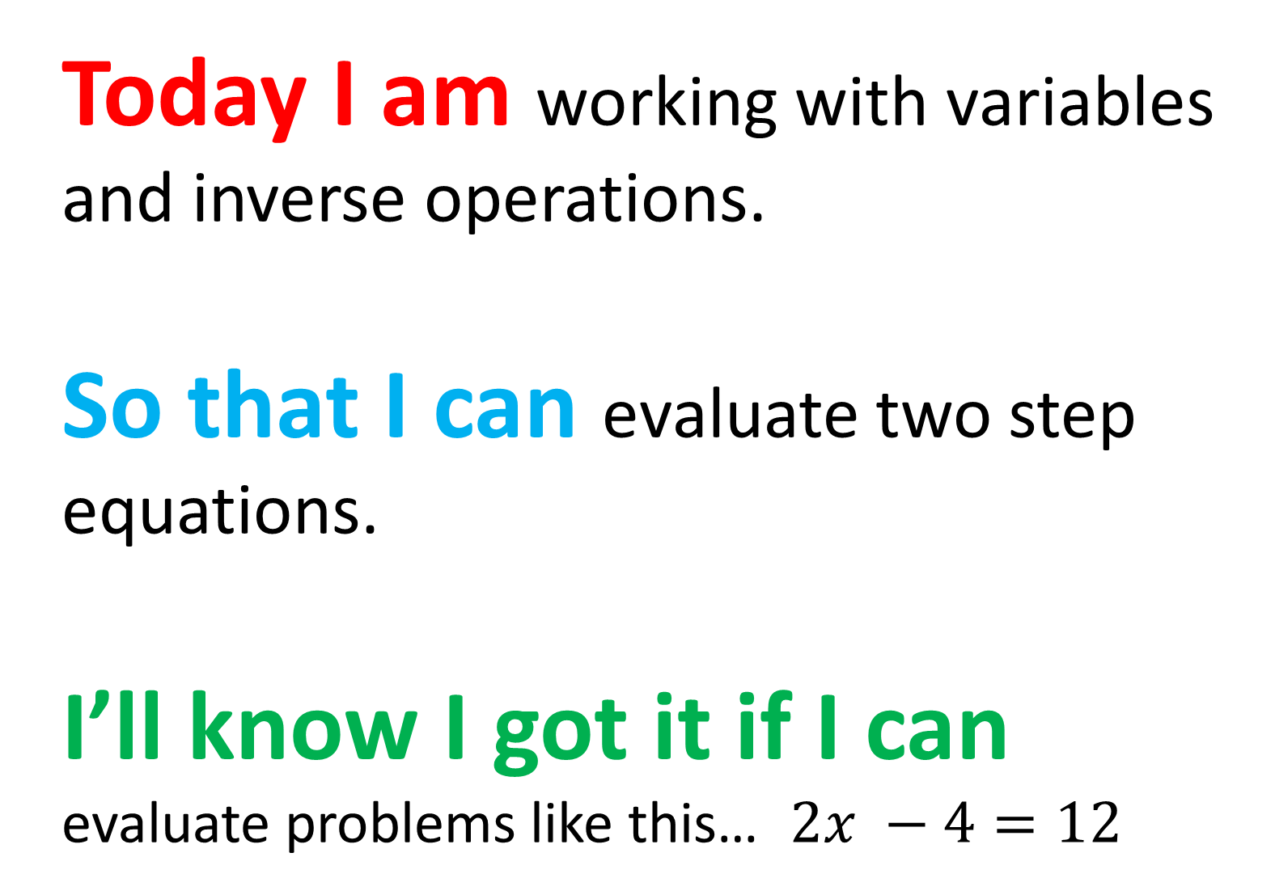
Today I am working with variables and inverse operations.
So that I can evaluate two step equations.
I’ll know I got it if I can evaluate problems like this… $2x −4=12$

Slide 5
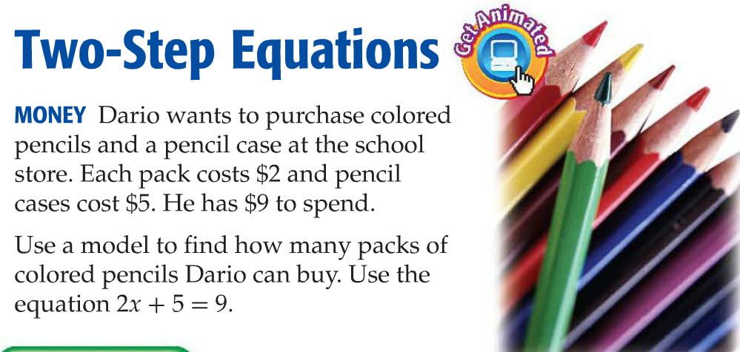
Solve a Two-Step Equation
Let x = the number of packs of pencils
We need to find out how many packs of pencils Dario can buy.

Slide 6
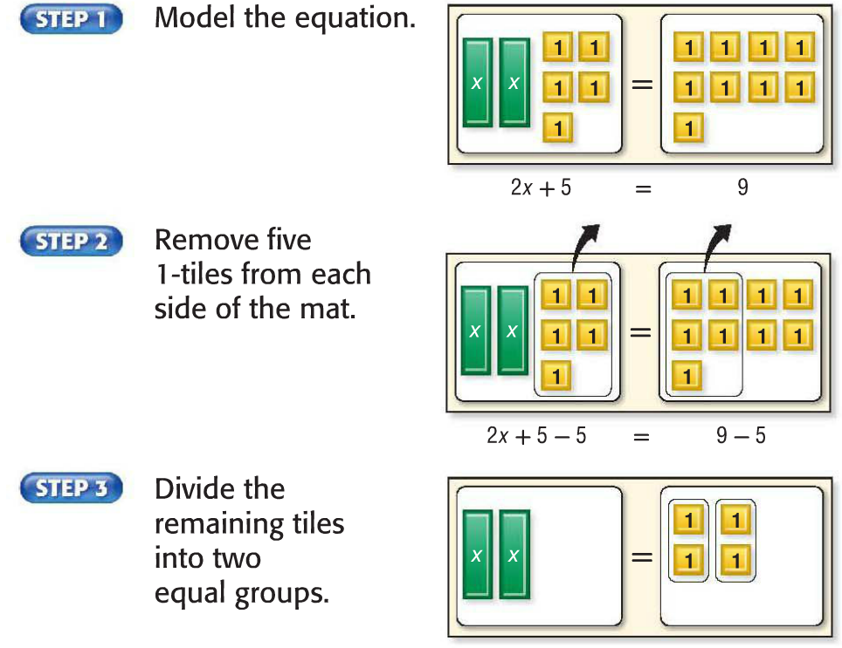
Solve a Two-Step Equation
Frequently algebra tiles are used to model equations.
You might see algebra tiles on the FSA so you should know what they mean!
Each “x” represents one occurrence of the unknown number.
Each “1” represents one unit or a one. Sometimes “+” is used in place of the “1” to represent one unit.

Slide 7

Solve a Two-Step Equation
Take away five ones
Take away five ones
Remember the scale?
Whatever you do to one side of an equation, you must do to the other side to keep it balanced.

Slide 8

Solve a Two-Step Equation
Two occurrences of “x” would look like 2x.
Recall that the touching operator is Multiply!
The opposite of multiply by 2 is divide by 2.
Remember to do this on both sides of the equation!

Slide 9
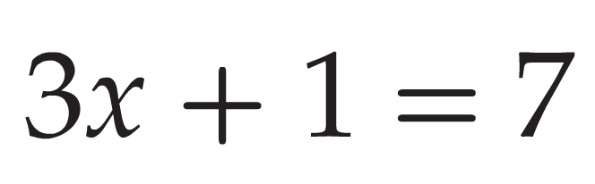

Solve a Two-Step Equation
Use algebra tiles to model and solve this problem.
Your turn to try! Copy this down.
=
x
x
x
+
+
+
+
+
+
+
+

Slide 10

Solve a Two-Step Equation
It’s a balancing act!
=
x
x
x
+
+
+
+
+
+
+
+
+
+
=
x
x
x
+
+
+
+
+
+
=
x
x
x
+
+
+
+
+
+
x = 2

Slide 11
Solve a Two-Step Equation
As with one-step equations, you solve two-step equations working backwards.
Think about the following question:
Did you notice anything special about the order in which the operators were handled when you solved the previous problem?
Discuss with your shoulder partner:
Predict a rule for the order you should handle the operators when working backwards.
Share with the class:
What pattern did you notice during the examples?

Slide 12
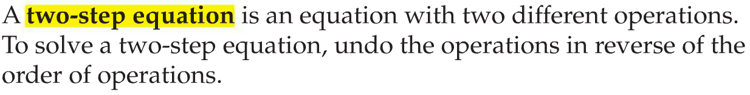
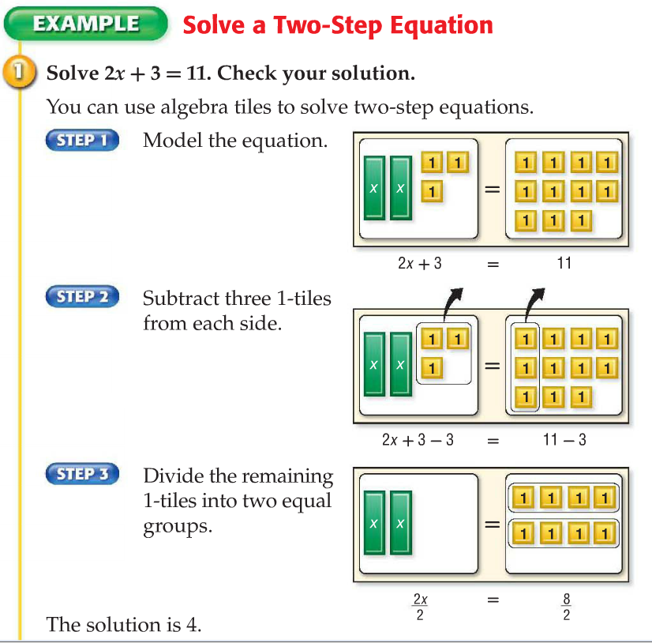
Solve a Two-Step Equation
What will you do to “undo” plus 3? Remember, you always start ON THE VARIABLE side!

Slide 13
Solve a Two-Step Equation
Notice the use of the fraction bar for division.

Slide 14


Draw a wall and begin by “undoing” the addition on both sides.
Now You Try!
Remember, use the Order of Operations in reverse!
3x + 6 = 18
- 6 = - 6
3x = 12
3 3
x = 4
3n + 4 = 13
- 4 = - 4
3n = 9
3 3
n = 3
3(4) + 6 = 18
3(3) + 4 = 13

Slide 15
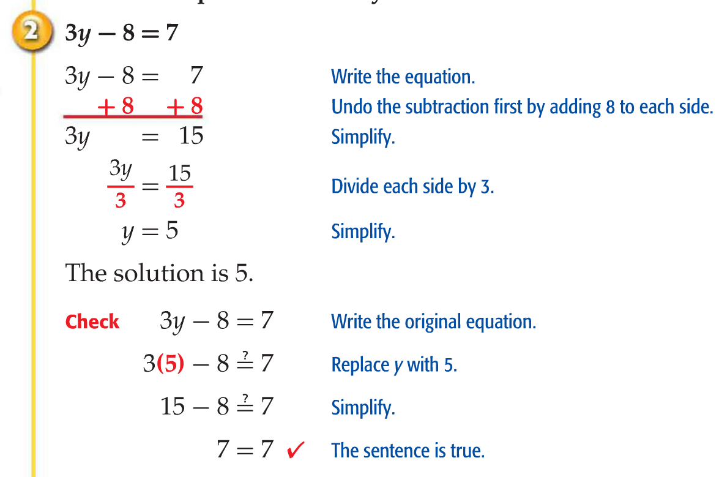
Solve a Two-Step Equation
Subtraction is handled the same way! Just use inverse operations.

Slide 16
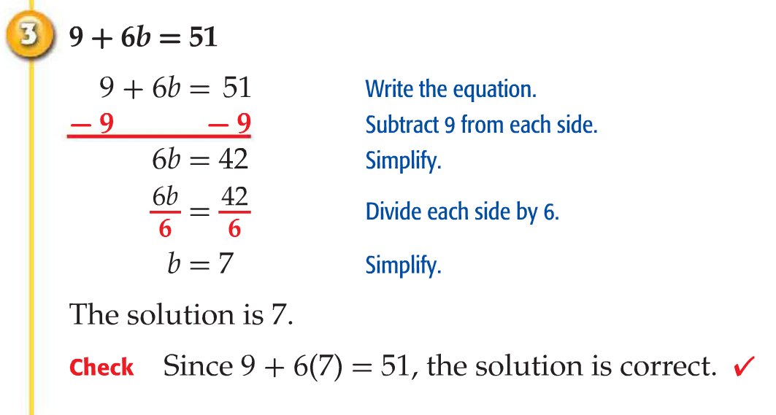
Solve a Two-Step Equation
It doesn’t matter where the variable is located. You must “undo” all addition and subtraction on the variable side first!

Slide 17
Draw a wall and begin by “undoing” the subtraction on both sides.
Your Turn Again!
Remember, use the Order of Operations in reverse!
5x - 4 = 16
+ 4 = + 4
5x = 20
5 5
x = 4
8 + 7m = 50
- 8 = - 8
7m = 42
7 7
m = 6
5(4) + 4 = 24
8 + 7(6) = 50

Slide 18
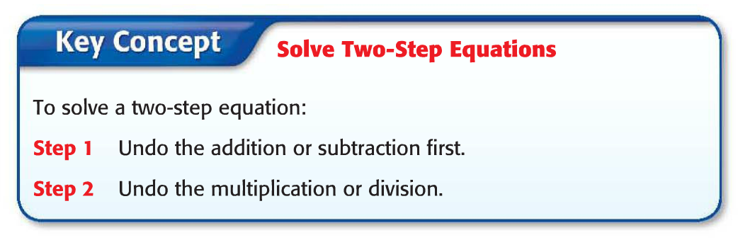

So, what exactly does this mean?
Key Concept
We solve problems working forward.
We solve for variables working backward.
So, we solve problems using the Order of Operations.
We solve for variables using the Order of Operations in REVERSE!

Slide 19
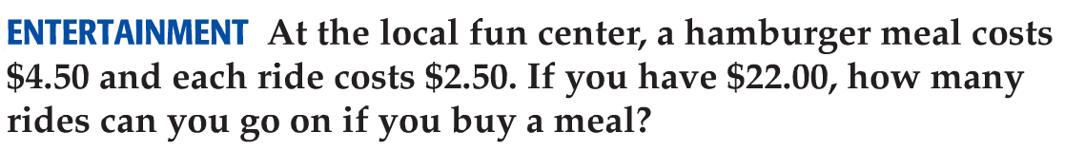
Find key words!
Real-World Example
Let r = the number of rides you can afford
Look for any words that mean add, subtract, multiply or divide.
Look for the statement of equality. It tells what is on one side of the equal sign.
4.50 + 2.50r = 22.00
- 4.50
- 4.50
2.50r = 17.50
2.50
2.50
r = 7
So, you can afford seven rides.

Slide 20
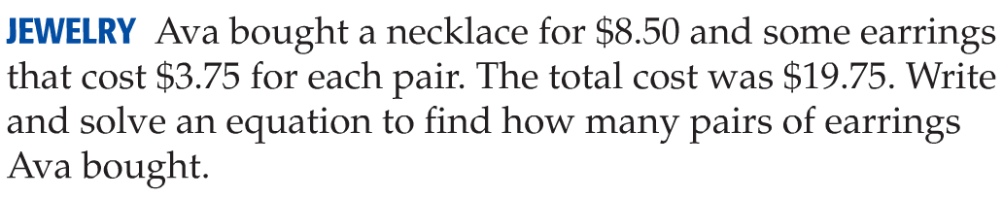
Real-World Example
Let e = the number of pairs of earnings Ava bought
Check with your shoulder partner when you are finished.
8.50 + 3.75e = 19.75
- 8.50
- 8.50
3.75e = 11.25
3.75
3.75
e = 3
So, Eva bought three pairs of earrings.

Slide 21
Let’s Recall What You’ve Learned
In your spiral, in your own words write the steps for solving a two-step equation.
On page 398 complete question numbers:
1, 3, 5 and 7
When you’ve finished, discuss your solutions with your shoulder partner.
Make any revisions necessary.

Slide 22
Time to Practice!
Complete pages 113 – 114 odd in your workbook.
Use lined paper and show your work!
Remember to keep your equations balanced.

