Slide 1
BellworK
List as many words as you can think of that are related to the term “graph”
Turn to your shoulder partner and compare lists
Graph

Slide 2
Graphs and Function Tables
8-1A and 8-1C:
6th Grade Advanced/Pre-IB Mathematics

Slide 3
Represent and analyze quantitative relationships between dependent and independent variables.
Learning Objectives:
I can use variables to solve real world problems.
I can use graphs, tables, and equations to analyze the relationship between dependent and independent variables.
I can write an equation to express the dependent variable in terms of the independent variable.
Learning Goal 603

Slide 4
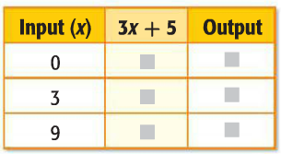
Today I am working with the coordinate plane and using one and two step equations.
So that I can graph ordered pairs and complete function tables.
I’ll know I got it if I can complete this function table and graph the
ordered pairs.

Slide 5
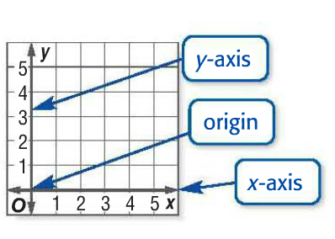
What is a coordinate plane?
Formed when two number lines intersect at their zero points
(4 , 3)

Slide 6
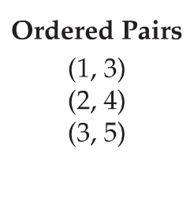
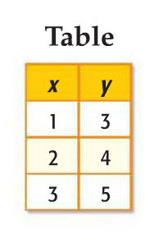
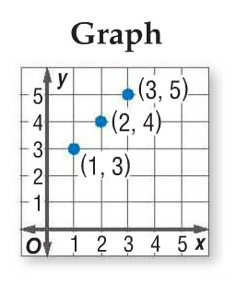
Other FORMS OF ORDERED PAIRS

Slide 7
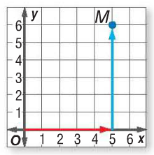
EXAMPLE: Graph the Point m(5,6)
“You must walk in an elevator before you can go up!”
Start at the origin
Z
Move 5 units to the right on the x-axis
Y
Then move up 6 units to locate the point
X
Check your progress:
1. X(6,0) 2. Y(2,5) 3. Z(3,6)
Draw a dot and label the dot M

Slide 8
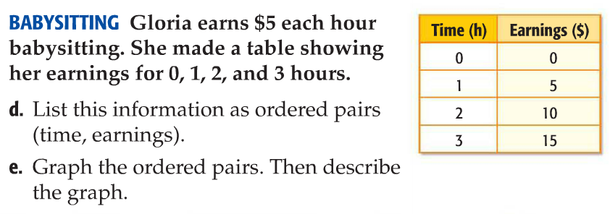
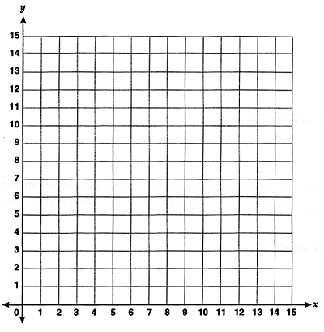
EXAMPLE
d. (0,0), (1,5), (2,10), (3,15)
e. The points, when connected, form a straight line.

Slide 9
FUNCTION TABLES
A function is a relation that assigns exactly one output value to one input value.

Slide 10
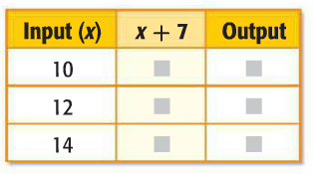
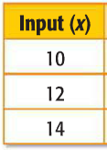
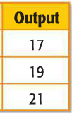
IMAGINE a FUNCTION MACHINE
Example
x + 7
Each input goes into the function machine and the machine produces an output.

Slide 11
CHECK YOUR PROGRESS
4 – 4
7 – 4
10 – 4
0
3
6
3(0)
3(2)
3(5)
0
6
15
(4,0), (7,3), (10,6)
(0,0), (2,6), (5,15)

Slide 12
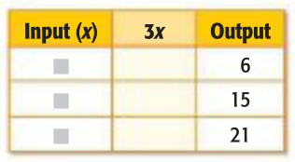
Think, Pair, Share
What if you are given the output before the input?
3x = 6
3x = 15
3x = 21
2
5
7

Slide 13
CHECK YOUR PROGRESS
5
6
9
1
2
3
2x – 1= 1
2x – 1 = 3
2x – 1 = 5
3x + 2= 17
3x + 2 = 20
3x + 2 = 29

Slide 14
BRAIN BREAK

Slide 15
EXIT SLIP
Page 425 #2, 4, 6, 8
Turn into the bin when finished
HOMEWORK REMINDER:
WB pages 115-116 ODDS
WB pages 117-118 ODDS
due Friday (white) or Monday (green)

