Slide 1
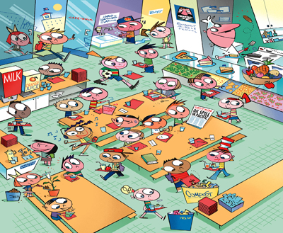
Bellwork (in your spiral)
The school cafeteria sells lunch passes that allow a student to purchase any number of lunches in advance.
Lunches (n) | 1 | 2 | 3
Total Cost (t) | 3 | 6 | 9
Write an equation to find t, the total cost in dollars for a lunch pass with n lunches.
Graph the ordered pairs from the function table on a coordinate plane.
Analyze the graph.
Determine how much it would cost to purchase 25 lunches.

Slide 2
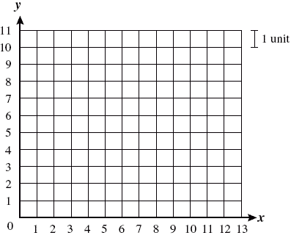
Bellwork Answers
Lunches (n) | 1 | 2 | 3
Total Cost (t) | 3 | 6 | 9
Write an equation to find t, the total cost in dollars for a lunch pass with n lunches.
t = 3n
b. Graph the ordered pairs.
c. Analyze the graph.
The graph makes a line because it’s a linear function.
(1,3)
(2,6)
(3,9)
d. Determine how much it would cost to purchase 25 lunches.
25 $×$3 = $75

Slide 3
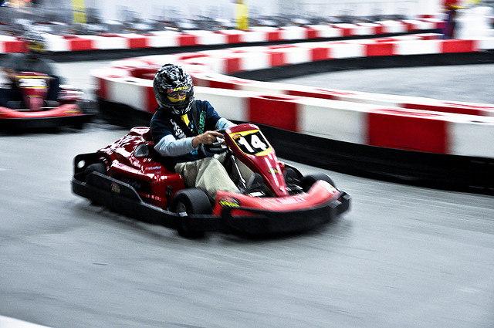
Bellwork (in your spiral):
Quickwrite: What is the difference between the two signs? How does it affect the go-kart riders?
You must be exactly 12 years old to ride the go-karts.
You must be at least 12 years old to ride the go-karts.

Slide 4
8-2 Inequalities
Do these symbols look familiar?

Slide 5
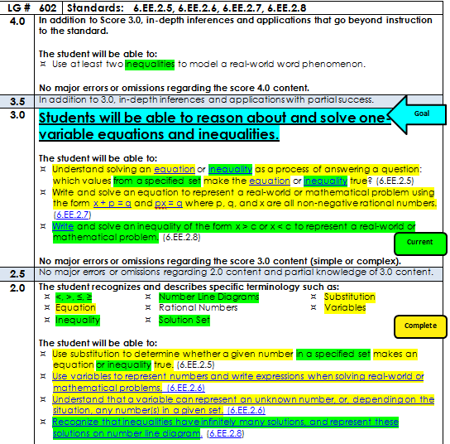
Open your data folder to the second page,
“LG 602.”

Slide 6
Today I am working with inequalities. quat So that I can solve and graph one step inequalities. I’ll know I got it if I can solve and graph the following inequality.
$$x −4 >11$$

Slide 7
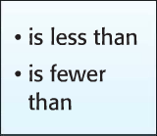
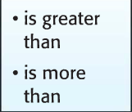
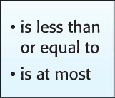
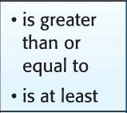
Inequality
WRITE THIS DOWN!!!
A mathematical sentence that compares quantities

Slide 8
Graphing Inequalities
$$<and >$$
$$≤and ≥$$
Example: $n >5$
Step 1: Draw a number line with your answer in the middle of the number line.
Step 2: Draw a circle over the “5” and an arrow to the right.
4 5 6
4 5 6
Predict: Why is the circle open and the arrow to the right?

Slide 9
Let’s Review the Go-Kart Problem
A go-kart rider must be at least 12 years old to ride the go-karts. Graph this inequality.
12 is part of the solution set. Can you think of other numbers that would make the inequality true?
Let g stand for go-kart rider.
Turn to your shoulder partner and determine what inequality represents this scenario. How would you graph it?
$$g ≥12$$
11 12 13

Slide 10
Graph Each Inequality **For #3 and #4, write the inequality first.
1. $c ≥7$
2. $d < 10$
6 7 8
9 10 11
3. Kevin ran more than 5 miles.
4. Swim practice is at most 35 laps.
$$k >5$$
$$l ≤35$$
4 5 6
34 35 36

Slide 11
Round Robin
Beginning with Student A, discuss how you would graph the following inequality.
$$6 < y$$
If the number comes first, switch the order and switch the direction of the sign!
=
5 6 7
$$y > 6$$

Slide 12
Re-write the following inequalities.
$$9 ≥x$$
$$2 >g$$
$$x ≤9$$
$$g < 2$$

Slide 13
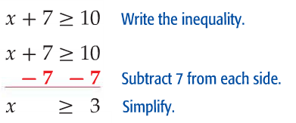
One-Step Inequalities
3 is part of the solution set. Can you think of other numbers that would make the inequality true?
$$x+7 ≥10$$
Think Pair Share: Predict how we will solve this inequality.
Use what you know about solving one-step equations to solve one-step inequalities!!

Slide 14
Your Turn: Solve and Graph
$$h −6 ≥ 13$$
$$7x > 56$$
+ 6 + 6
$÷$ 7 $÷$ 7
$$h ≥19$$
$$x >8$$
18 19 20
7 8 9

Slide 15
Inequalities in Word Problems
Lauren is making party favor bags for each of her 7 friends attending her birthday party. She does not want to spend more than $42 on the party favors. Write and solve an inequality to find the maximum cost for each party favor bag.
Let c stand for the cost of each party favor bag.
$$7c ≤42$$
$$c ≤6$$
$÷$ 7 $÷$ 7
Each bag should cost no more than $6.

Slide 16
Two-Step Inequalities
Solve $9n +5 >32$
Quickwrite: Explain your prediction for solving the inequality.
Share your prediction with your shoulder partner…
$$9n +5 >32$$
$−$ 5 $−$ 5
$$n >3$$
$$9n > 27$$
$÷9$ $÷9$

Slide 17
Open your data folders to LG 602 again…
Exit Slip: Reflect on this learning goal
I rated myself a level _____ on (today’s date). I know I am a level _____ because _______.

Slide 18
Homework
WB pages 131-132 ODDS due Monday (white) or Tuesday (green)

