Slide 1
9-1 C and D: Area of Triangles and Trapezoids
6th Grade Advanced Mathematics

Slide 2
Learning Goal 610
Solve real-world and mathematical problems involving area.
Learning Objectives:
I can draw polygons on the coordinate plane when given the vertices.
I can find the length of a side of a polygon graphed on the coordinate plane.
I can determine the area of squares and rectangles.
I can calculate the area of triangles
I can calculate the area of special polygons by breaking the polygon into familiar shapes.
I can take everything I’ve learned about area and apply it to real-world situations.

Slide 3
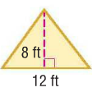
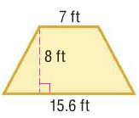
Today I am working with triangles and trapezoids.
So that I can find their area. I’ll know I got it if I can find the area of each figure.

Slide 4
Think Pair Share
What are your predictions for the formula we will use to find the area of a triangle based on what we know about a rectangle and parallelogram’s area formula?

Slide 5
Area of a Triangle
Review: What is the area of a rectangle and parallelogram?
$Area=base ×height$
What shape forms when you cut each of these shapes in half?
A TRIANGLE!!!
So, the area of a triangle is…
$Area=(base ×height)$ $÷2$ or $\frac{1}{2}(base ×height)$

Slide 6
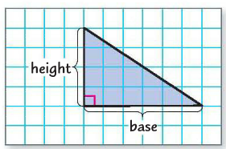
Example 1 – Find the area of the triangle
Base = 6 units
Height = 4 units
$$Area=\left(base ×height\right) ÷2$$
$$A=\left(6×4\right) ÷2$$
Area = 12 square units
$$A=24 ÷2$$

Slide 7
Check Your Progress
$$Area=\left(base ×height\right) ÷2$$
$$A=\left(10×5\right) ÷2$$
$$A=\left(9×7\right) ÷2$$
$$A=50 ÷2$$
$$A=63 ÷2$$
A = 25 square units
A = 31.5 square units

Slide 8
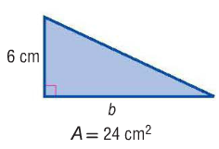
Example 2 – Find the base of the triangle
$$Area=\left(base ×height\right) ÷2$$
$$24=\left(b ×6\right) ÷2$$
$$×2 ×2$$
$$48=\left(b ×6\right)$$
Base = 8 cm
$$÷6 ÷6$$

Slide 9
Check Your Progress
$$Area=\left(base ×height\right) ÷2$$
$$A=\left(5×4\right) ÷2$$
4 cm
$$A=20 ÷2$$
5 cm
A = 10 square cm

Slide 10
BRAIN BREAK

Slide 11
Area of a Trapezoid
$$b_{1}$$
$$b_{2}$$
$$h$$
$$b_{2}$$
$$b_{1}$$
$$Area= \frac{1}{2}h(b_{1}+b_{2})$$

Slide 12
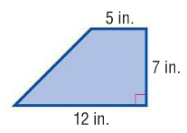
Example 1 – Find the area of the trapezoid
$$b_{1}=5$$
$$b_{2}=12$$
$$h=7$$
$$Area= \frac{1}{2}h(b_{1}+b_{2})$$
$$A= \frac{1}{2}(7)(17)$$
$$A= \frac{1}{2}(7)(5+12)$$
$$A= \frac{1}{2}(119)$$
$$A=59.5 square inches$$

Slide 13
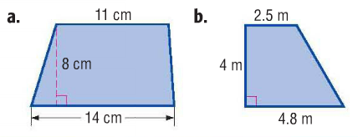
Check Your Progress
$$b_{1}=11 b_{2}=14 h=8$$
$$b_{1}=2.5 b_{2}=4.8 h=4$$
$$A= \frac{1}{2}(8)(11+14)$$
$$A= \frac{1}{2}(4)(2.5+4.8)$$
A = 100 square cm
A = 14.6 square m

Slide 14
Homework
WB pages 137 #3, 5, 7, 11
WB pages 139 #1, 3, 5, 8
Due Thursday (white) or Monday (green)

