Slide 1
Take out a new piece of paper and title it “Chapter 9 Mid Chapter Check”
Turn to page 511
Solve #1, 2, 3, 6, 7, 8
You have 20 minutes

Slide 2
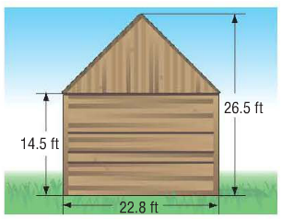
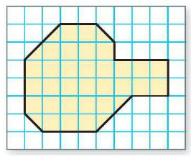
9-3 B and C: Area of Irregular and Composite Figures
6th Grade Advanced Mathematics

Slide 3
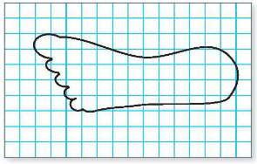
Quickwrite:
Predict how you would find the area of the following figure.

Slide 4
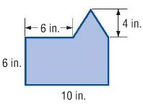
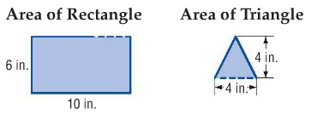
Example 1 – Find the area
The figure can be separated into a rectangle and a triangle. Find the area of each.
So, the area is 60 + 8 or 68 square inches.

Slide 5
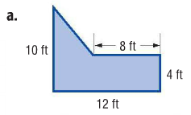

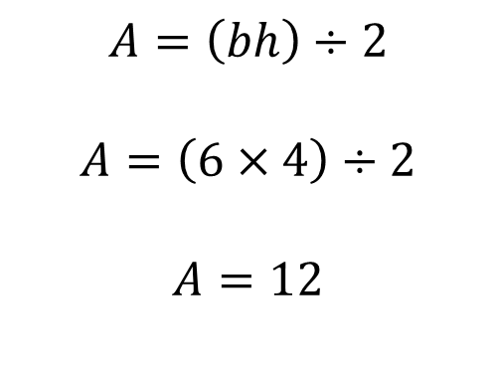
Check Your Progress – Work with a shoulder partner to find the area.
Area of Rectangle
Area of Triangle
So, the area is 48 + 12 or 60 square feet.
$$A=bh$$
$$A=12 ×4$$
$$A=48$$
$$A=\left(bh\right)÷2$$
$$A=\left(6×4\right)÷2$$
$$A=12$$

Slide 6
Homework
WB page 147 #3, 5, 7 due Tuesday (white) or Wednesday (green)

