Slide 1
Big Idea 1
Multiplication and Division of Fractions and Decimals

Slide 2
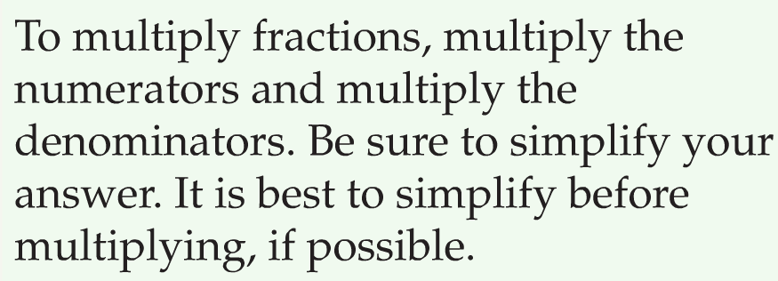
Multiplying Fractions
All mixed numbers are converted to improper fractions!
All whole numbers have a denominator of 1!

Slide 3
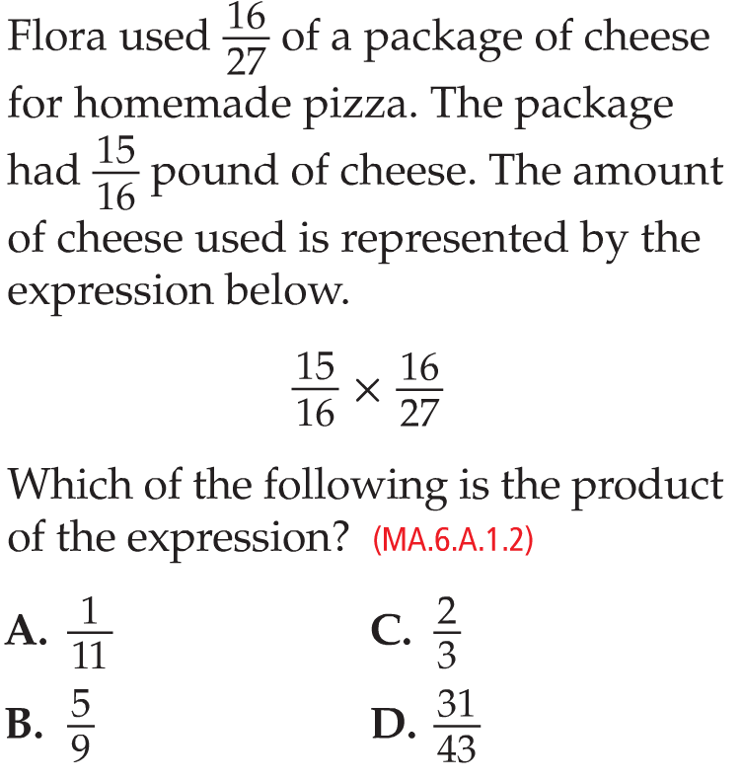
Multiplying Fractions
B.

Slide 4
Dividing Fractions

Slide 5
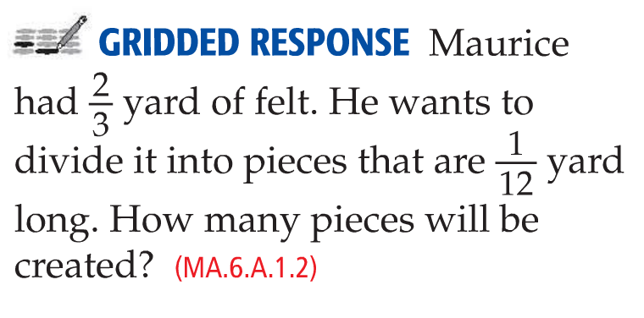
Dividing Fractions
8 pieces

Slide 6
Multiplying Decimals

Slide 7
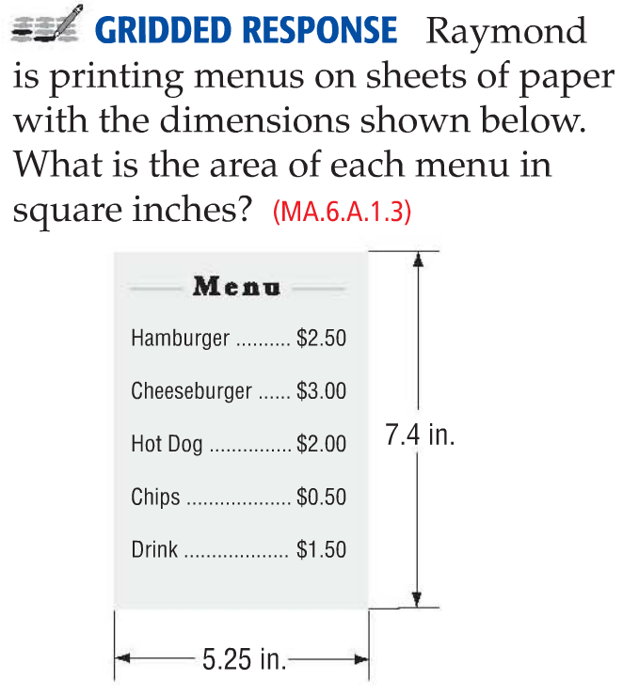
Multiplying Decimals
38.85 in²

Slide 8
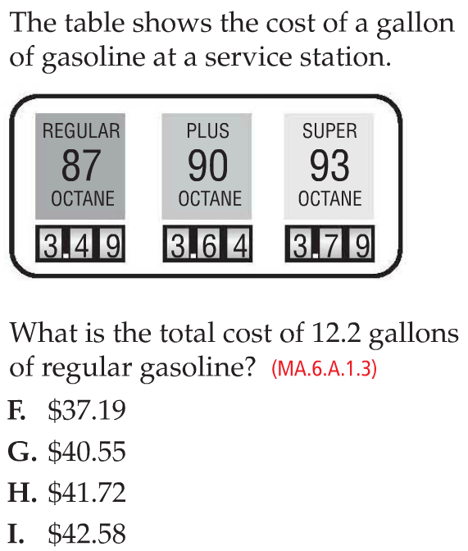
Multiplying Decimals
I

Slide 9
Dividing Decimals

Slide 10
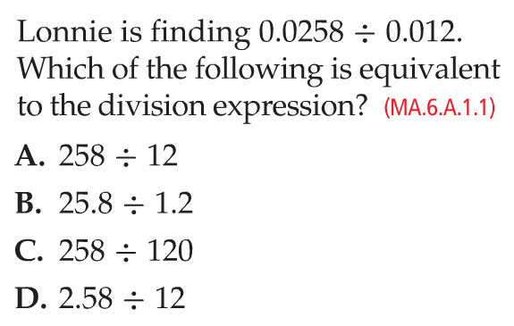
Dividing Decimals
At least your divisor must be a whole number!
C
or 25.8 ÷ 12

Slide 11
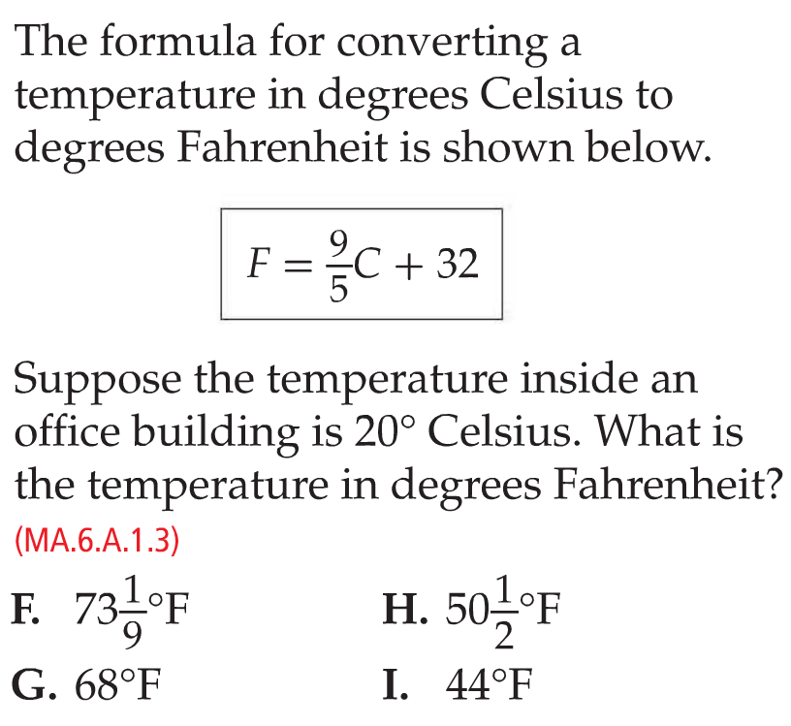
Mixed Problem Solving
G

Slide 12
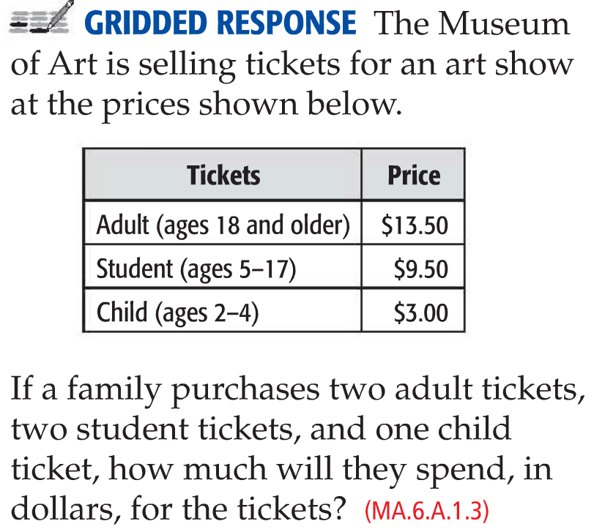
Mixed Problem Solving
$49.00

Slide 13
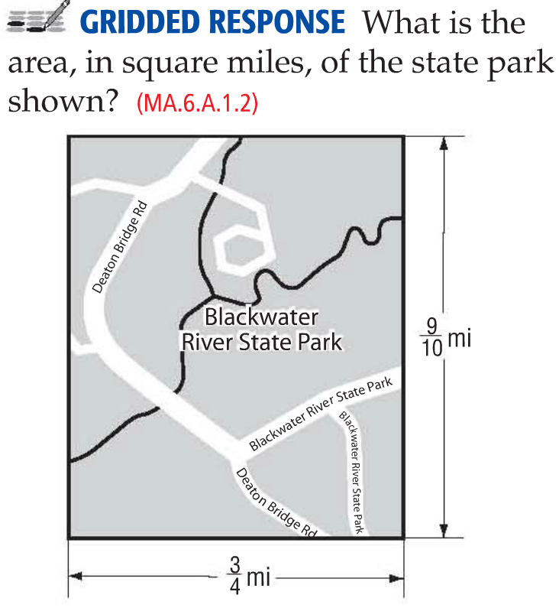
Mixed Problem Solving
27/40 mi²

Slide 14
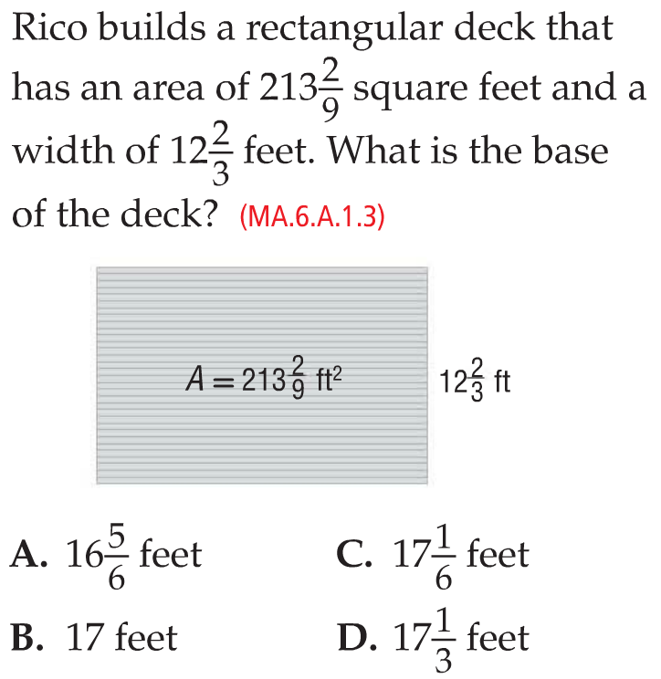
Mixed Problem Solving
A

Slide 15
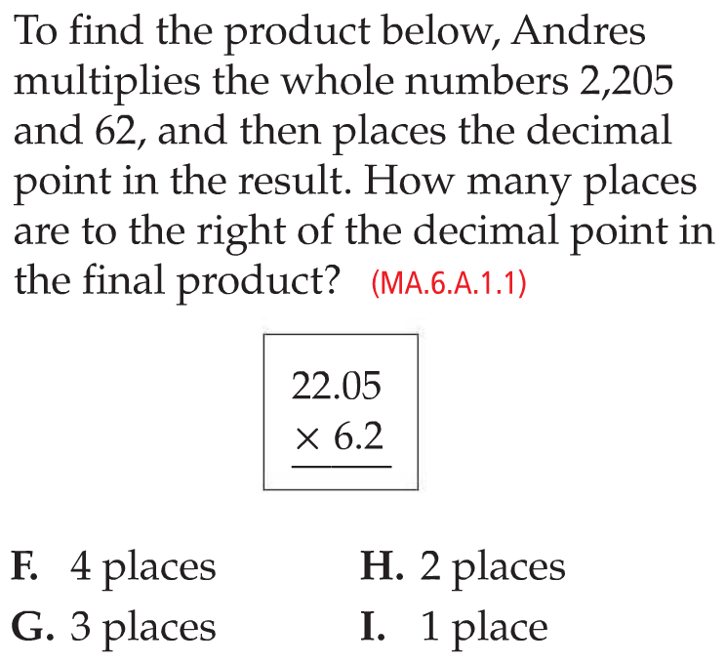
Mixed Problem Solving
G

Slide 16
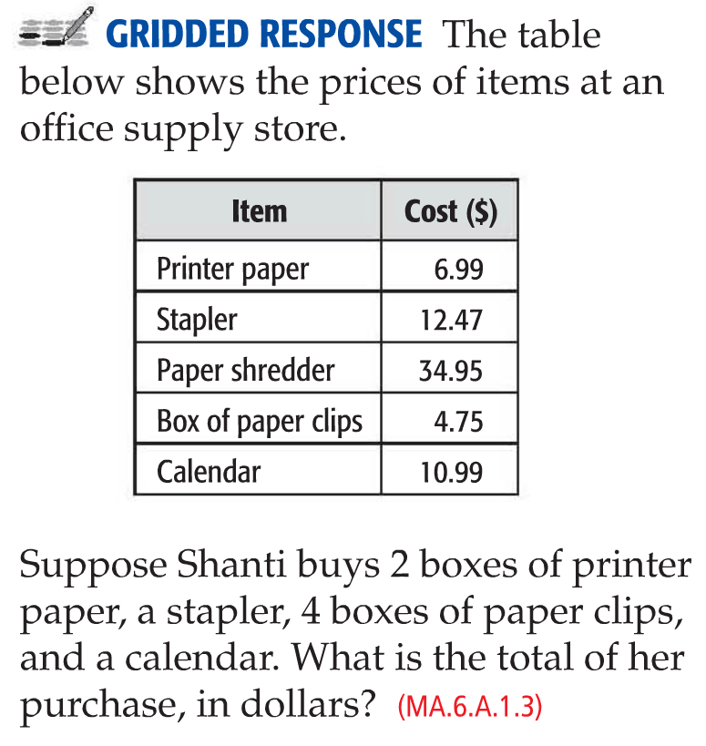
Mixed Problem Solving
$56.44

Slide 17
Big Idea 1
Multiplication and Division of Fractions and Decimals
Keep Practicing!

