Slide 1
Big Idea 2
Connect Ratios and Rates to Multiplication and Division

Slide 2
Write a Ratio
2 to 6
1 to 3

Slide 3
Write a Ratio
C

Slide 4
Write a Rate or Unit Rate

Slide 5
Find Unit Rate
When you divide the numerator by the denominator, you end up with a denominator of 1!
This is a proportion!

Slide 6
Find and Apply Unit Rate
I

Slide 7
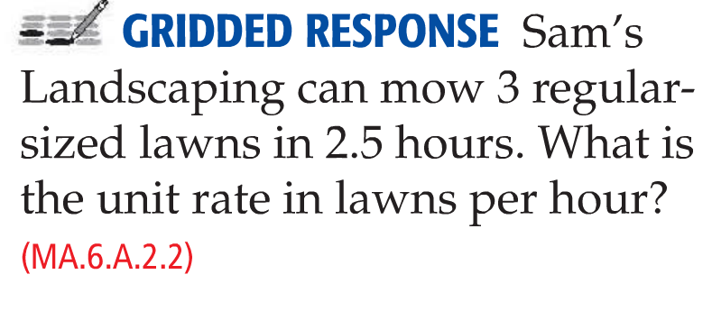
Find and Apply Unit Rate
1.2 Lawns Per Hour

Slide 8
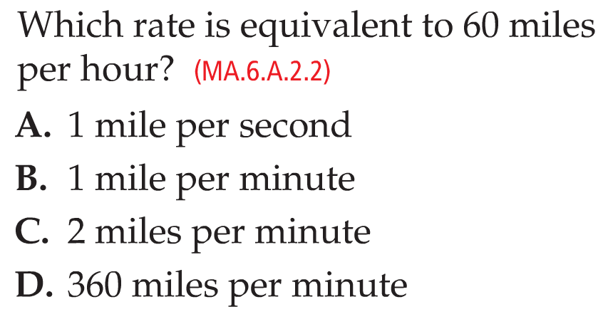
Find and Apply Unit Rate
B

Slide 9
Apply Ratios and Rates
984 cm³

Slide 10
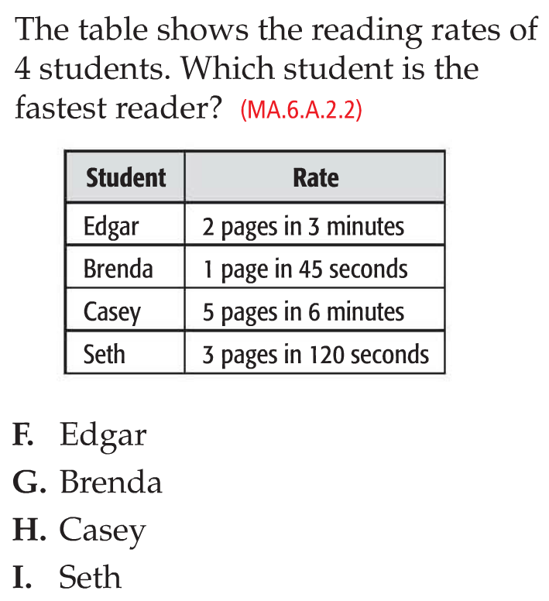
Apply Ratios and Rates
I

Slide 11
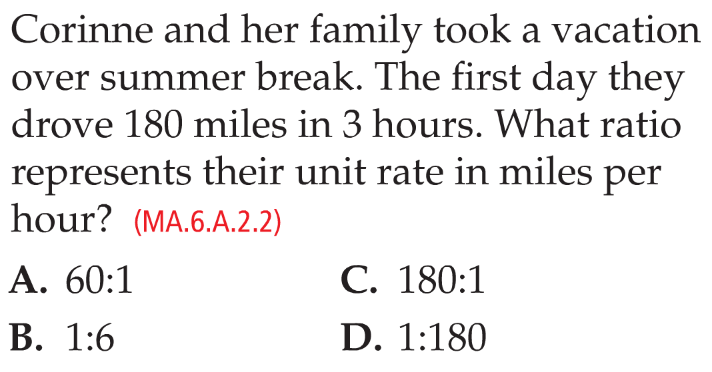
Mixed Problem Solving
A

Slide 12
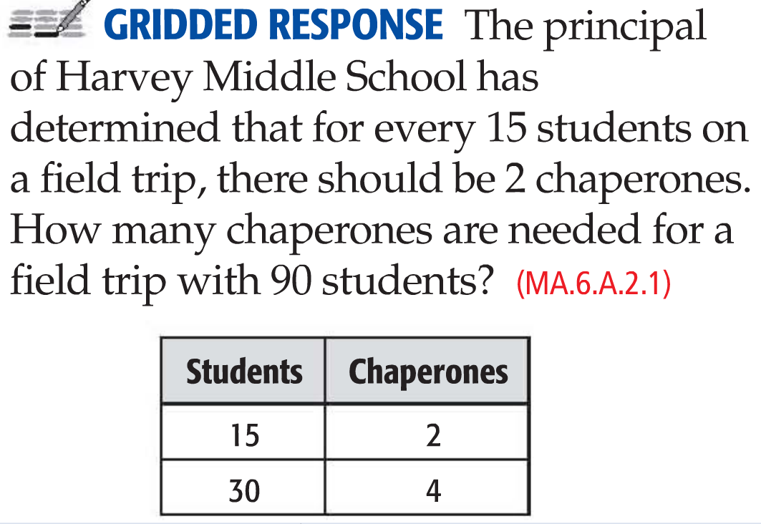
Mixed Problem Solving
12

Slide 13
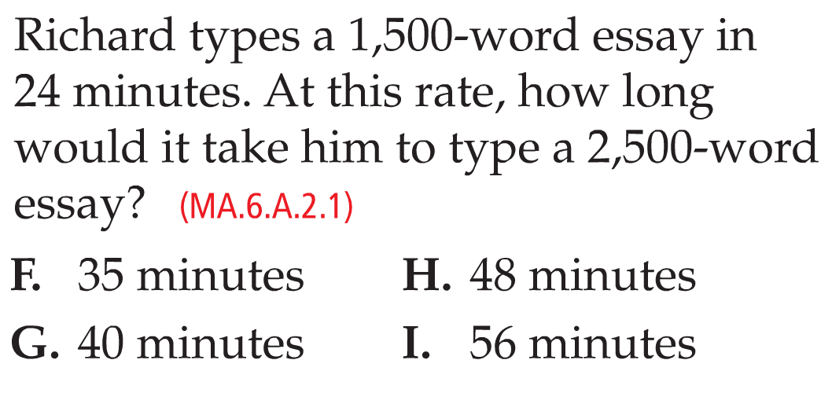
Mixed Problem Solving
G

Slide 14
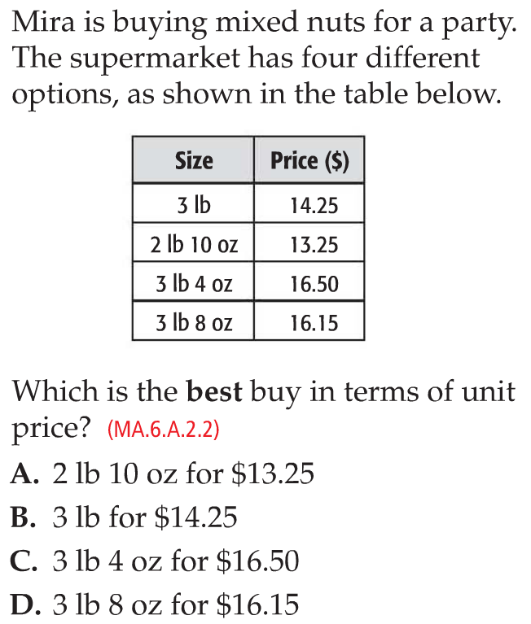
Mixed Problem Solving
D

Slide 15
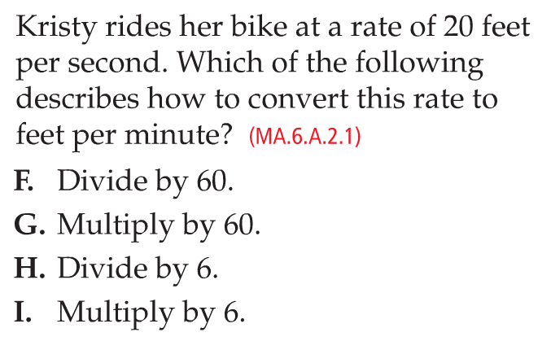
Mixed Problem Solving
G

Slide 16
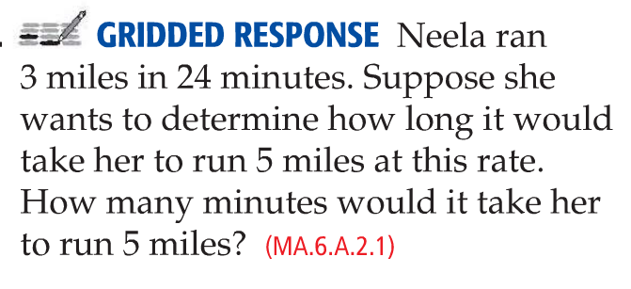
Mixed Problem Solving
40

Slide 17
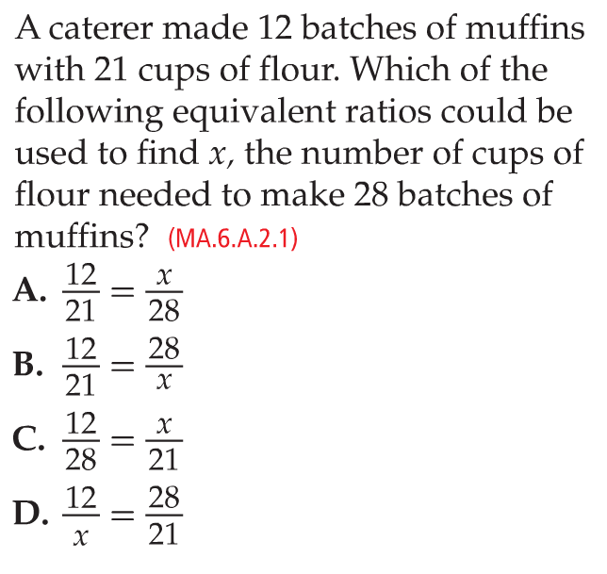
Mixed Problem Solving
B

Slide 18
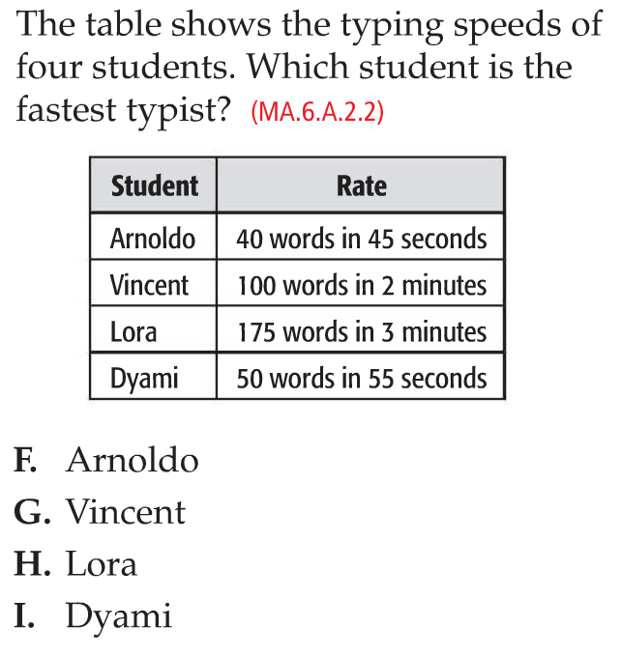
Mixed Problem Solving
H

Slide 19
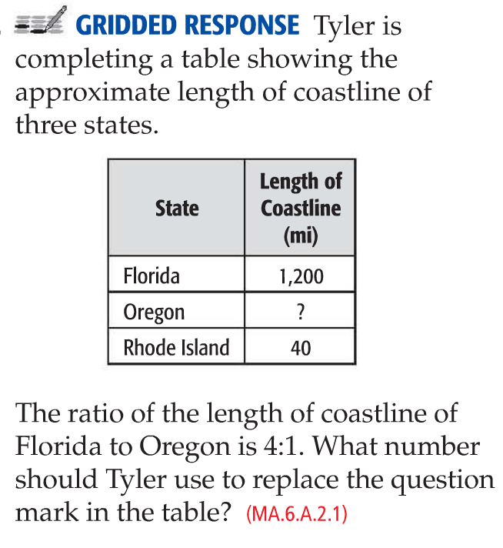
Mixed Problem Solving
300

Slide 20
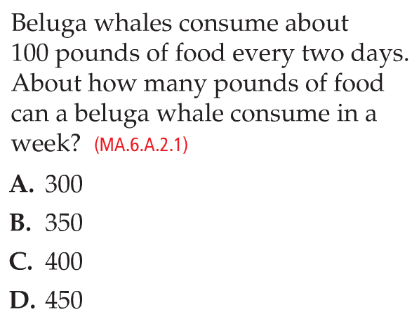
Mixed Problem Solving
B

Slide 21
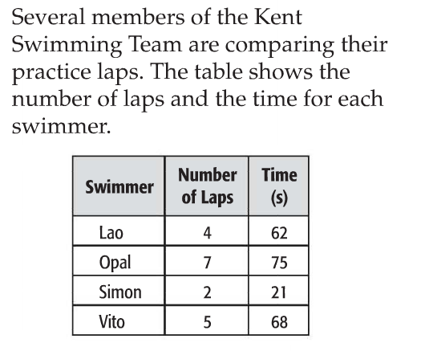
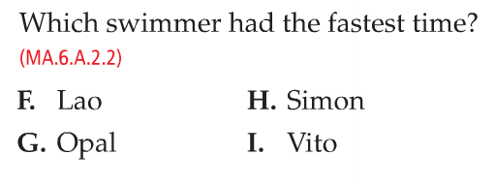
Mixed Problem Solving
H

Slide 22
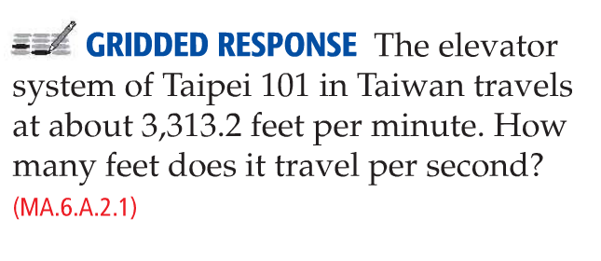
Mixed Problem Solving
52.22

Slide 23
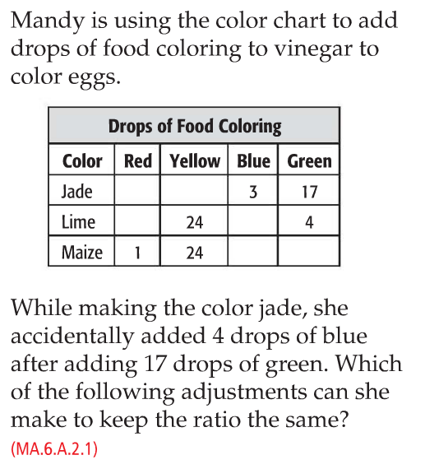
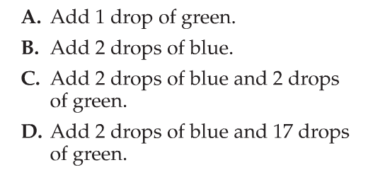
Mixed Problem Solving
D

Slide 24
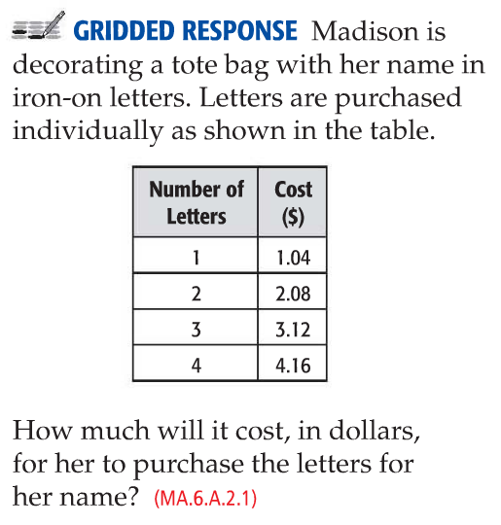
Mixed Problem Solving
7.28

Slide 25
Big Idea 2
Connect Ratios and Rates to Multiplication and Division
Keep Practicing!

