Slide 1
Chapter 2 review
6th grade Advanced/Pre-IB Math

Slide 2
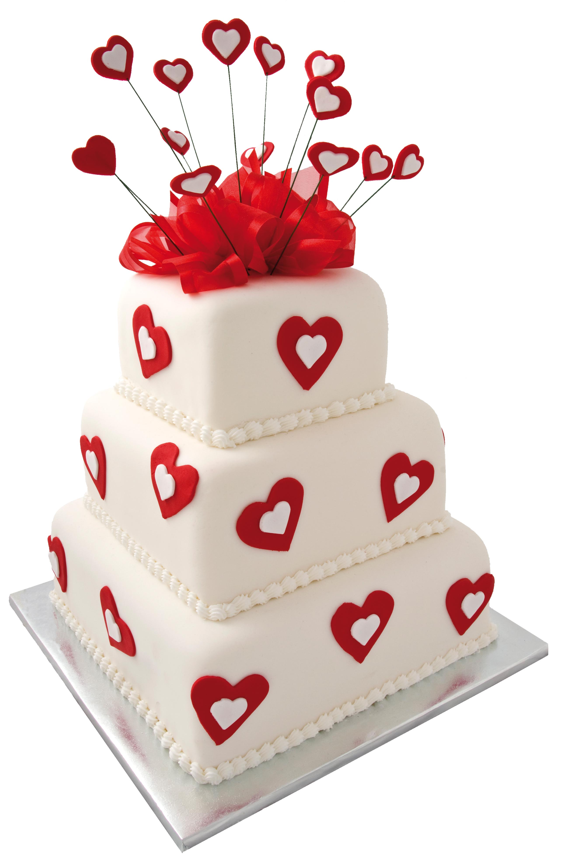
Multiple Choice
Jonas is decorating the top of a cake that measures 2 feet by $\frac{7}{8}$ foot. Find the area of the cake that will be decorated.
A. 2$\frac{2}{7}$ square feet C. 1$\frac{3}{4}$ square feet
B. 2$\frac{1}{4}$ square feet D. 1$\frac{5}{8}$ square feet
Correct answer: C. 1$\frac{3}{4}$ square feet (2 x $\frac{7}{8}$ )

Slide 3
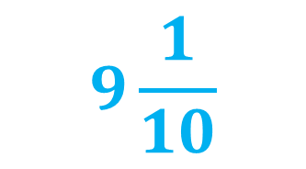
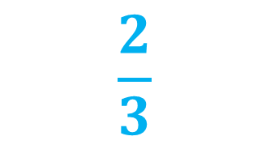
Multiply and write in SIMPLEST FORM
12 x $\frac{1}{3}$
4
$\frac{8}{9}$ x$\frac{3}{4}$
$$\frac{2}{3}$$
$3\frac{1}{2}$ x$2\frac{3}{5}$
$$9\frac{1}{10}$$

Slide 4
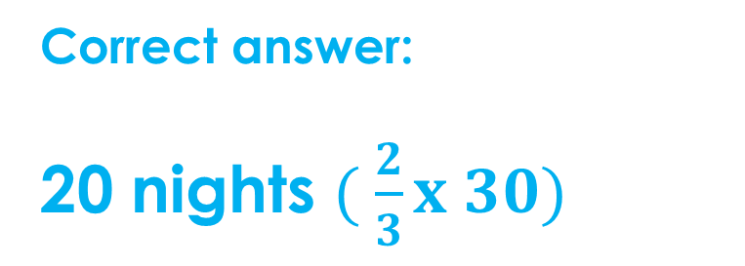
Solve
Kathleen studied $\frac{2}{3}$of the nights in the month. If the month has 30 days, how many nights did she study?
Correct answer:
20 nights $( \frac{2}{3}x 30)$

Slide 5
Answer the question.
What does “KCF” stand for?
Solve $\frac{6}{7}$ $÷ \frac{1}{5}$ using KCF.
Keep Change Flip
$\frac{6}{7}$ $x \frac{5}{1}=\frac{30}{7} or 4\frac{2}{7}$

Slide 6
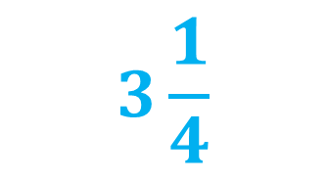
Divide and write in SIMPLEST FORM
21 $÷$ $\frac{1}{3}$
63
$\frac{9}{5}$ $÷ \frac{3}{5}$
3
$1\frac{5}{8}$ $÷ \frac{1}{2}$
$$3\frac{1}{4}$$

Slide 7
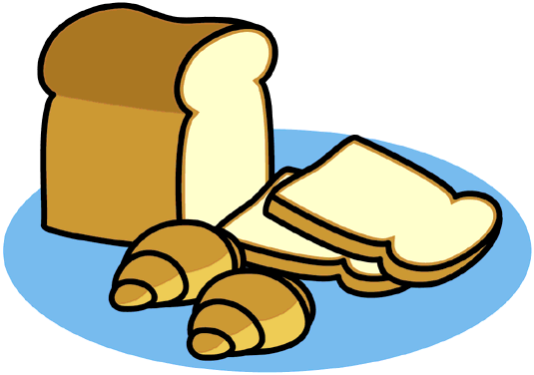
Baking
Jay is cutting a roll of biscuit dough into slices that are $\frac{3}{8}$ inch thick. If the roll is 10$\frac{1}{2}$ inches long, how many slices can he cut?
$10\frac{1}{2}$ $÷ \frac{3}{8}=\frac{21}{2}×\frac{8}{3} = \frac{168}{6} or 28 slices$

Slide 8
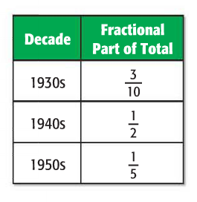
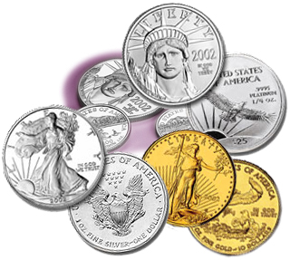
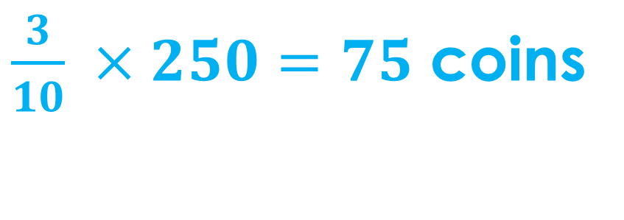
Coins
The table shows the fractional part of all the coins that come from different decades. If there are 250 coins in the collections, how many come from the 1930s?
$\frac{3}{10} ×250=75$ coins

