Slide 1
STINKY FEET
Chapter 3 Review

Slide 2
H. 97 centimeters

Slide 3
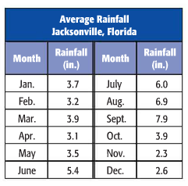
5.6
(7.9-2.3)

Slide 4
2 7 19 22 24 25 28 32 41
Median = 24

Slide 5
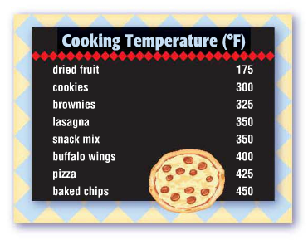
Identify the outlier in the data set.
175
Which measure of central tendency best describes the data?
Median and Mode

Slide 6
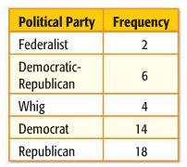
The mode is Republican. It means that more U.S. Presidents have been Republican than any other party.

Slide 7
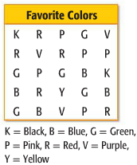
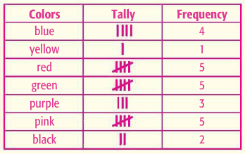
Red, green, and pink were chosen more than any other color.

Slide 8
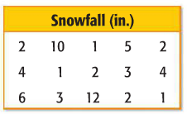
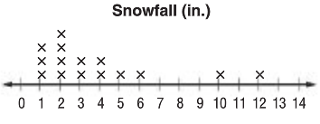
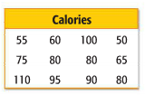
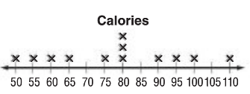

Slide 9
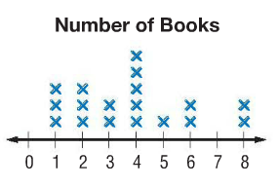
10 students
$\frac{13}{18}$

Slide 10
Bar Graph, it will compare the different prices
Line Graph, it will show her height over time

