Slide 1
Stinky Feet
Chapter 5 Review

Slide 2
Write each decimal as a fraction in simplest form
1. 0.35
$\frac{7}{20}$
$\frac{9}{125}$
2. 0.072
$2\frac{3}{5}$
3. 2.6

Slide 3
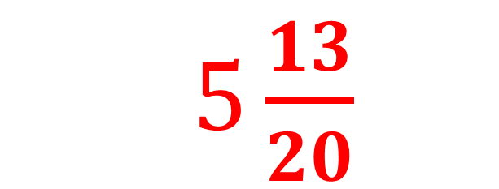
4.
$5\frac{13}{20}$

Slide 4
5.
$\frac{4}{5}$

Slide 5
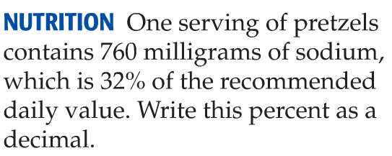
6.
0.32

Slide 6
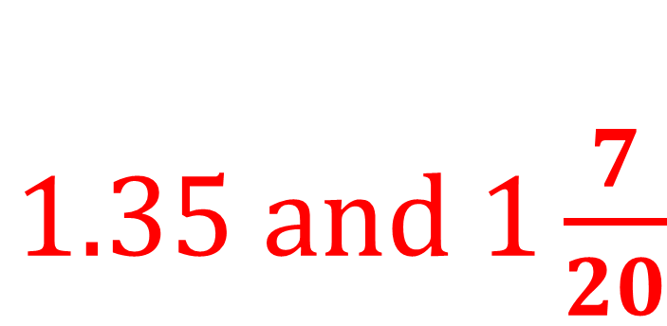
7.
$1.35 and 1\frac{7}{20}$

Slide 7
8.
9.
$$<$$
$$>$$
10.
$$=$$

Slide 8
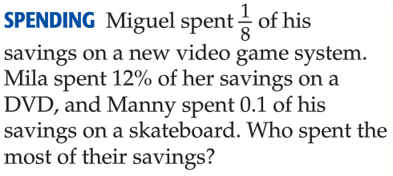
11.
Miguel (1/8 = 12.5%)

Slide 9
12.
10% of 800 = 80
About 80 students

Slide 10
13.
60% of 25 = 15 games

