Slide 1
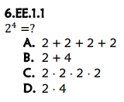
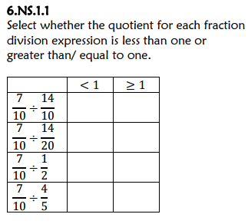
Complete on a piece of notebook paper. Put your heading in the upper right corner.
The title is “FSA Countdown: Week 1 Day 1”
X
X
477
X
X
7

Slide 2
Complete on the same piece of notebook paper.
The title is “FSA Countdown: Week 1 Day 2”
12
2.712
11
24

Slide 3
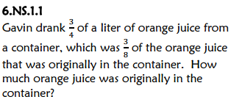
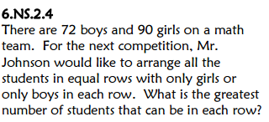

Complete on the same piece of notebook paper.
The title is “FSA Countdown: Week 1 Day 3”
1.70829
2 Liters
$3^{4}+36$ or
${ 3}^{4} +$ $6^{2}$
GCF = 18 students

