Slide 1
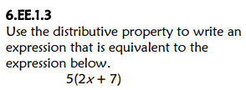
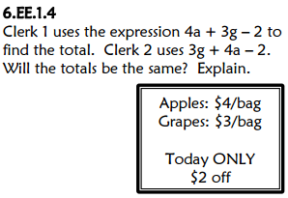
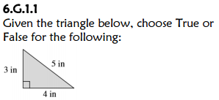
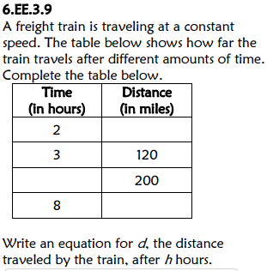
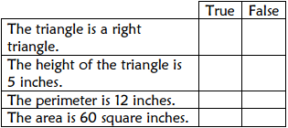
Title your paper “FSA Countdown: Week 3 Day 1”
Yes. Both expressions are equivalent.
10x + 35
x
80
d = 40h
x
5
320
x
x

Slide 2
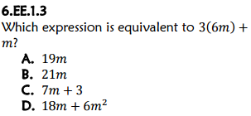
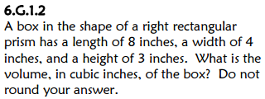
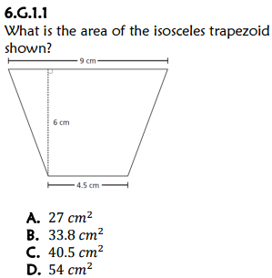
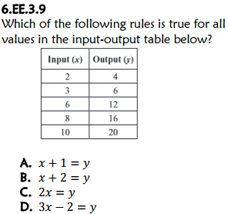
*Title the same paper “FSA Countdown: Week 3 Day 2”
A
96 cubic inches
8 cm
4 cm
23 square cm
3.5 cm
C

