Slide 1
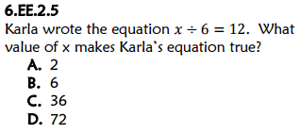
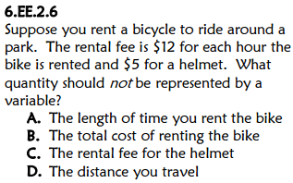
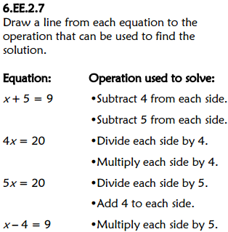
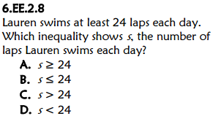
Title your paper “FSA Countdown: Week 4 Day 1”
D
C
A

Slide 2
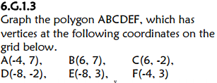
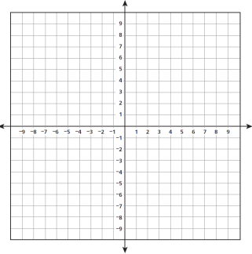
*Title the same paper “FSA Countdown: Week 4 Day 2”
Find the area of polygon ABCDEF.
110 square units
A
B
E
F
Find the perimeter of polygon ABCDEF.
D
C
46 units

Slide 3
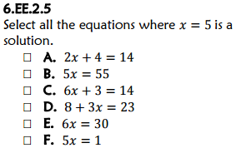
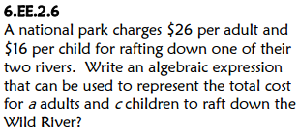
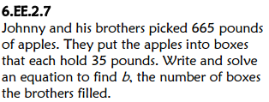
Title the same paper “FSA Countdown: Week 4 Day 3”
26a + 16c
35b = 665 b = 19

