Slide 1
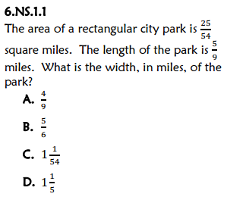
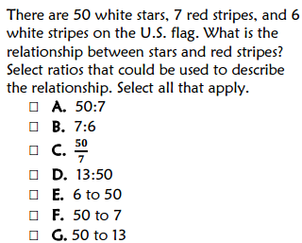
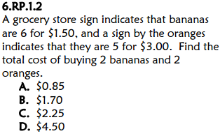
Title your paper “FSA Countdown: Week 5 Day 1”
B
B
450 words

Slide 2
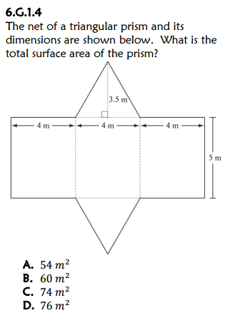
*Title the same paper “FSA Countdown: Week 5 Day 2”
C
8.64 square cm

Slide 3
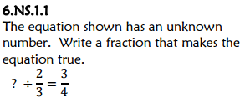
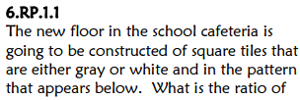
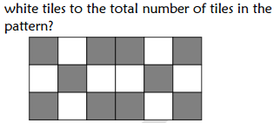
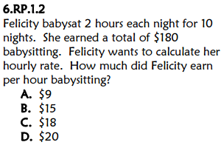
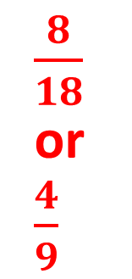
Title the same paper “FSA Countdown: Week 5 Day 3”
$$\frac{1}{2}$$
$\frac{8}{18}$ or $\frac{4}{9}$
A
38 miles

