Slide 1
Milwee Middle School
Math Night
2014-2015

Slide 2
Transition to the Florida Standards
How will your child be affected in their Mathematics class?

Slide 3
Transition to the Florida Standards
Content area standards are similar
Some skills have moved to different grade levels
Major shift in the way students are asked to think and problem solve

Slide 4
Instructional Shifts With The Florida Standards
Focus
Coherence
Fluency
Deep Understanding
Application
Dual Intensity

Slide 5
Student Expectations In Response to the Instructional Shifts
Focus | Spend more time on fewer concepts
Coherence | Keep building on learning year after year
Fluency | Get faster by spending time practicing many problems on the same concept
Deep Understanding | UNDERSTAND why the math works MAKE the math work TALK about why the math works PROVE that they know why and how the math works
Application | Apply the mathematics to real-world situations
Dual Intensity | Be able to use core math facts FAST and EFFECTIVELY * AND * Be able to apply math in the real world SIMULTANEOUSLY

Slide 6
Critical Areas of Focus

Slide 7
Our Teaching has been Changing
Categories of Cognitive Demand
Higher – level Demands
Level of Rigor
Doing mathematics
Procedures with connections
Procedures without connections
Memorization
Lower – level Demands

Slide 8
Mathematical Practices
#1
Make sense of problems and persevere in solving them
#8
Look for and express regularity in repeated reasoning
#2
Reason abstractly and quantitatively
#3
Construct viable arguments and critique the reasoning of others
#7
Look for and make sense of structure
Standards
#6
Attend to precision
#4
Model with mathematics
#5
Use appropriate tools strategically

Slide 9
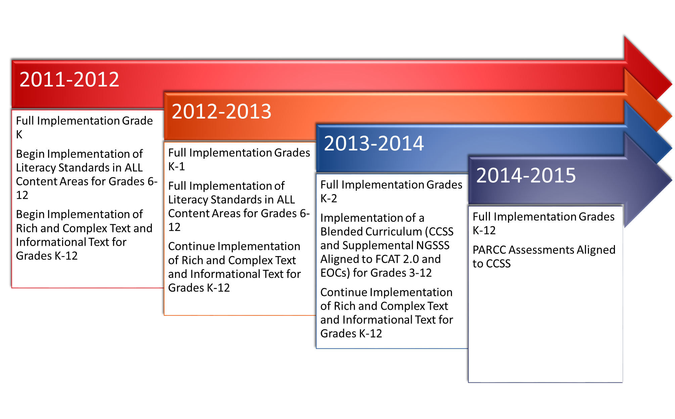
The Implementation Schedule

Slide 10
How Will Students be Assessed?
Students will take the new Florida Standards Assessment (FSA) this year
We are ensuring that all students receive the instruction necessary to prepare them for the FSA

Slide 11
FSA Mathematics Reporting Categories – 6th & 7th Grade
Reporting Category | % of Test (6th Grade) | % of Test (7th Grade)
Ratios & Proportional Relationships | 15% | 25%
Expressions & Equations | 30% | 21%
Geometry | 15% | 23%
Statistics & Probability | 19% | 16%
The Number System | 21% | 15%

Slide 12
FSA Mathematics Reporting Categories – 8th Grade
Reporting Category | % of Test (8th Grade)
Expressions & Equations | 30%
Functions | 25%
Geometry | 27%
Statistics & Probability and The Number System | 18%
For Mathematics grades 6–8, there are 62–66 items.

Slide 13
FSA Mathematics Percentage of Points by Cognitive Complexity
Grades | Low (one-step) | Moderate (multiple steps) | High (analyze & synthesize)
3-4 | 25-35% | 50-70% | 5-15%
5 | 10-20% | 55-75% | 10-20%
6-8 | 10-20% | 60-80% | 10-20%
Level of Rigor Increases as Grade Level Increases

Slide 14
The Types of Questions Have Changed
Multiple Choice
Gridded Response
Graphic Response Item Display (GRID)
Hot Text Items
Multi-Select Item
Open-Response Items
Equation Editor
Editing Task Choice
Editing Task
Table Item
Matching Item

Slide 15
FSA Question Types
Graphic Response Item Display (GRID)
Grid items require using point, line, or arrow buttons to create a response.
Students may select numbers, words, phrases, or images and use the drag-and-drop feature to place them into a graphic.

Slide 16
FSA Question Types
Hot Text Items
Hot Text items require you to either click on a response option or drag a response option to another location.

Slide 17
FSA Question Types
Multi-Select Items
Multi-select items allow you to select more than one answer option.

Slide 18
FSA Question Types
Open-Response Item
Open-response items require you to use the keyboard to enter the response into a text field.

Slide 19
FSA Question Types
Equation Editor
Equation items require you to enter a valid statement that answers the question, such as y = 3x + 2.

Slide 20
FSA Question Types
Editing Task Choice
Students will be required to select a highlighted task or phrase which will reveal a dropdown menu. Students will have the options of either correcting word/phrase or leaving it as is to indicate a lack of error.
Editing Task
Students will be required to select a highlighted task or phrase which will reveal a dropdown menu. Students will replace the highlighted task/phrase with the correct answer.

Slide 21
FSA Question Types
Table Item
Students will be required to complete parts of a table or entire tables.
Matching Item
Students will check a box to indicate if information from a column header matches information from a row.

Slide 22
FSA Scoring
Scores are based on three measures:
T Score - This score is based off of a scale.
Percentile Rank - This score compares a student’s performance to the performance of all students who took the same test in the state of Florida.
Raw Score -This score compares the actual number of questions students earned to the total amount of points possible.

Slide 23
Levels of Performance
Above Proficient (FCAT 2.0 Levels 4 & 5) indicates success within the content on the FSA by answering most questions correctly.
PROFICIENT (FCAT 2.0 Level 3) indicates partial success with the content on the FSA.
Limited Proficiency (FCAT 2.0 Levels 1 & 2) indicates limited success with the content on the FSA.
Proficiency is the goal for each student.

Slide 24
Achievement Levels
With FCAT 2.0, the exam became more rigorous as the grade level increased. With FCAT 2.0 the same scale score did not equal the same level of proficiency each year. We expect similar trends with the FSA.
Example:
5th Grade Score 247 = Level 5
6th Grade Score 247 = Level 4
7th Grade Score 247 = Level 3

Slide 25
How Are We Preparing?
Administering assessments with FSA features
Questions are based off of the grade level’s FSA Test Item Specifications (TIS)
Engage NY and Amplify Math Tasks and Projects
Varied question formats
Examples include: short response, multi-select response, graphic response, and table response.

Slide 26
Our Objective As Mathematics Teachers
Provide support to all students as they strive to achieve an annual learning gain
Teach each course focusing on the content area standards
Support each student by preparing them for the transition to the standards which have been adopted by our state
Prepare them for whatever exam is administered to assess proficiency with the current standards

Slide 27
How Are We Preparing Specific Grade Levels or Courses?
Grade Specific Sessions will answer questions.
Grade Level | Location
6th Grade | Cafeteria
7th Grade | Media Center
Algebra (7th and 8th Grade) and Geometry Only | Building 10 – Room 209
8th Grade Standard Mathematics | Concretable 3
Please proceed to break out session locations.

