Slide 1
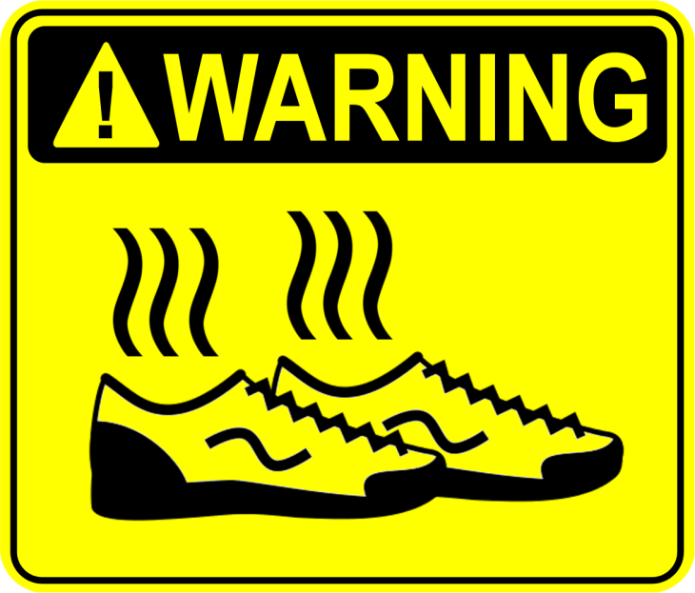
STINKY FEET
Midterm Review
6th Grade Advanced/Pre-IB Math

Slide 2
MULTIPLY
1. 7.8 x 6
46.8
2.
25.56 square feet

Slide 3
DIVIDE
3. 7.2 ÷ 3
2.4
4.
$42.50

Slide 4
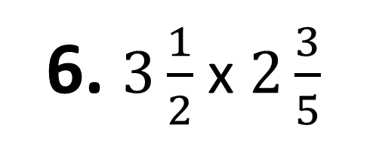
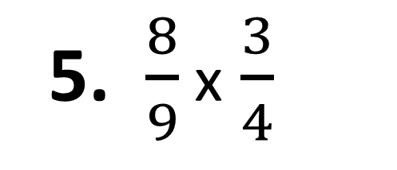
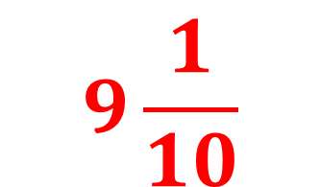
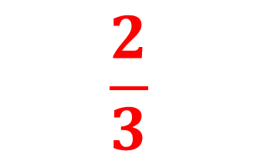
Multiply and write in SIMPLEST FORM
5. $\frac{8}{9}$ x$\frac{3}{4}$
$$\frac{2}{3}$$
6. $3\frac{1}{2}$ x$2\frac{3}{5}$
$$9\frac{1}{10}$$

Slide 5
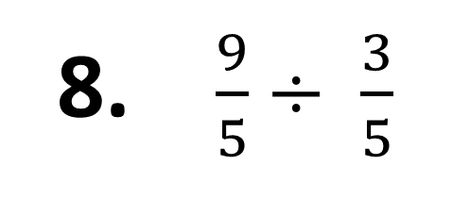
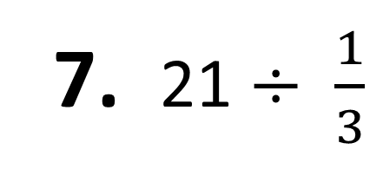
Divide and write in SIMPLEST FORM
7. 21 $÷$ $\frac{1}{3}$
63
8. $\frac{9}{5}$ $÷ \frac{3}{5}$
3

Slide 6
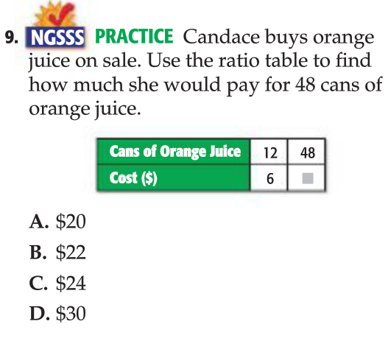
C. $24

Slide 7
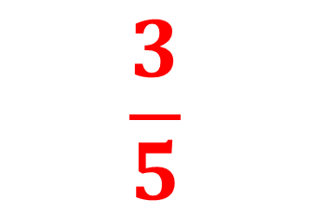
WRITE THE RATIO AS A FRACTION IN SIMPLEST FORM
10.
$$\frac{3}{5}$$

Slide 8
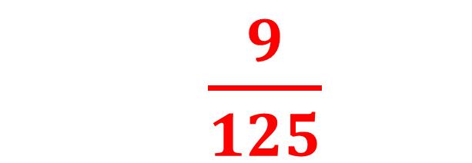
Write the decimal as a fraction in SIMPLEST FORM
$\frac{9}{125}$
11. 0.072

Slide 9
Find each percent of a number
12.
14 athletes
13.
3 members

Slide 10
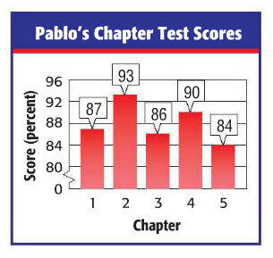
Find the mean for the data set
14.
88

Slide 11
Find the median, mode, and range for the data set
Minutes spent on homework: 18, 20, 22, 11, 19, 18, 18
Median: 18
Mode: 18
Range: 11

Slide 12
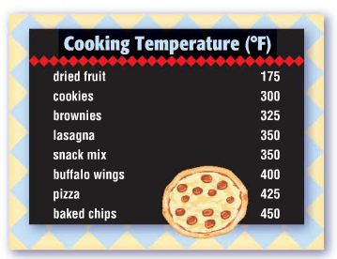
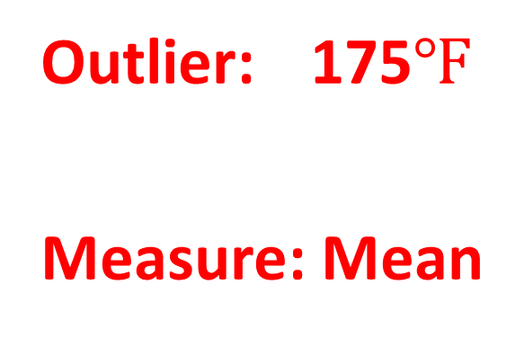
Identify the outlier in the data set. Then, determine which measure of central tendency is affected most.
Outlier: 175$℉$
Measure: Mean

